Slide 1
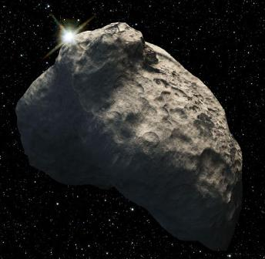
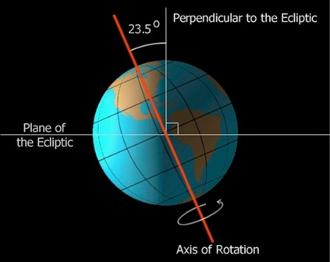

Turning history on its head
Massive evidence of a global flood
What does it all mean?
Part 9 – Where did the water come from?
and where did it go?
End Time Issue Ministries
Dr James A Robertson PrEng
Notes:
Northcliff again?
As the first presentation?
Or a view of the sea?
Or a view of the sea and Northcliff – replace the brown with blue?

Slide 2
Displacement in steady state requires external force
New movement requires a change in state in terms of the forces acting on an object
Any evidence of a change in state is evidence of an external force acting on the earth
What do we see?
Massive sedimentary – water impelled – deposits
Massive igneous intrusions – Granite Domes, etc
Massive cutting away
Massive erosion
All speak to external forces
Much of what follows is a recap of points made in previous sections
Notes:
Potato masher video clip
Stable rotating sphere unlikely to experience what we have witnessed, how to start that process?
Introduce instability
Massive destruction is high speed – the collapsing building example – maybe show it again?

Slide 3
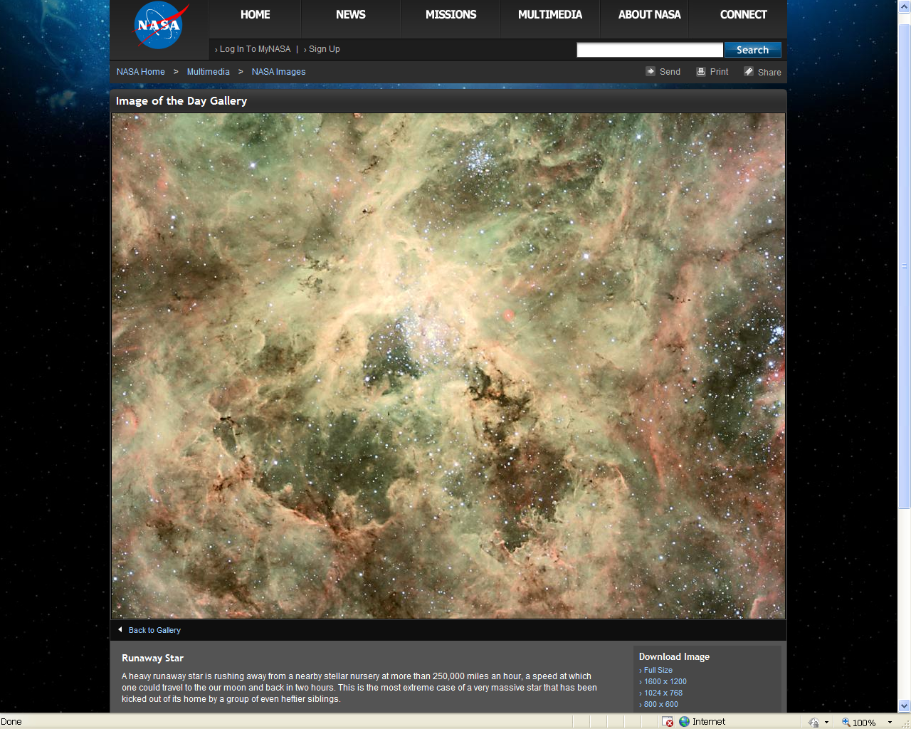
We live in an unstable Universe massive runaway star earth to Moon in 1 hour

Slide 4
Massive blocks of ice in space
Kuiper Belt

Slide 5
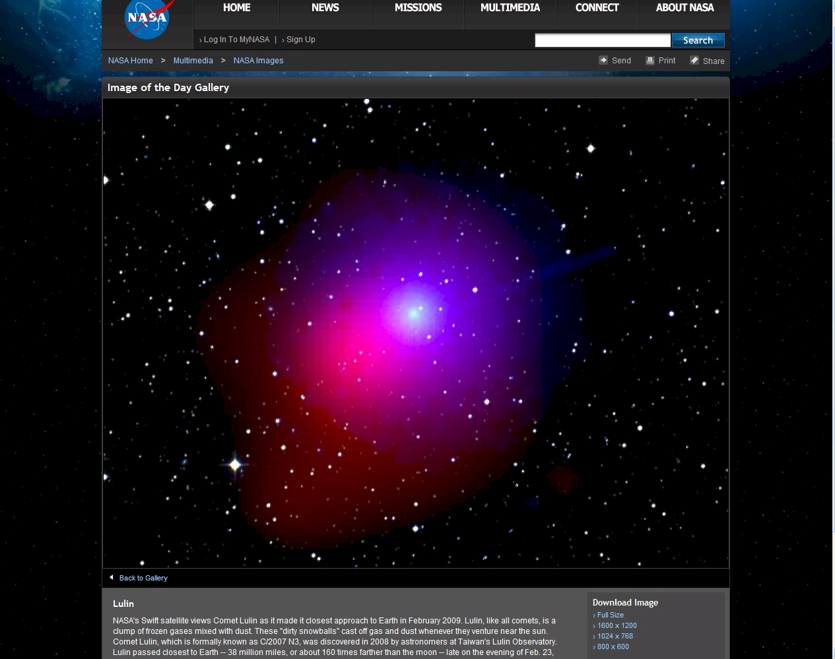
Dirty snowball in space

Slide 6
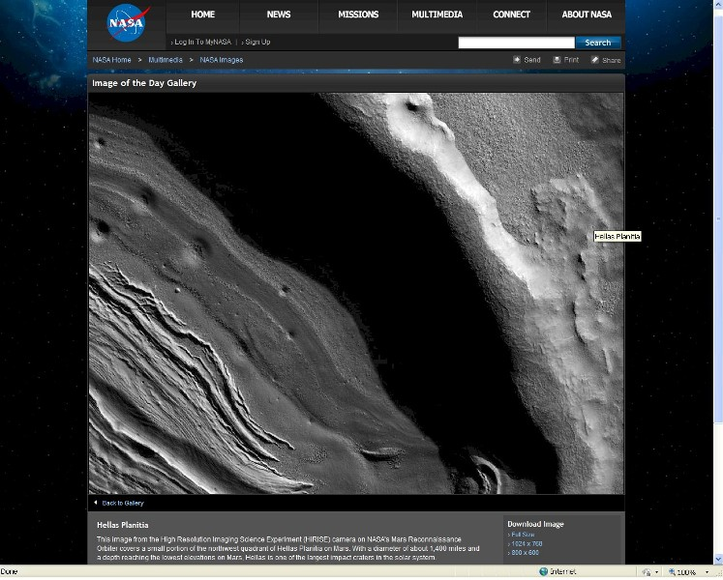
Ice impact on Mars?

Slide 7
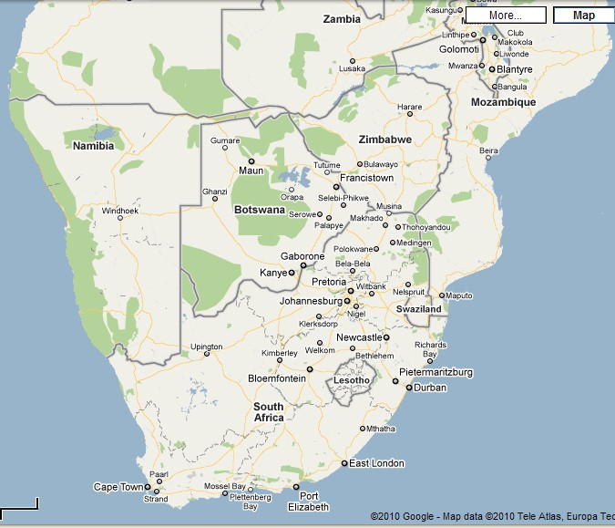
Hellas Planitia superimposed on South Africa -- might melt partially as it passed through the atmosphere

Slide 8
Some other theories about where the water came from
Any ice object striking the atmosphere would melt partially or completely before striking the surface
Water in vapour canopy before the flood precipitates as a consequence of comet fly-by or impact
Bodies of water stored under the crust, referred to in Genesis as “the Fountains of the deep” break open
Surface disruption triggers volcanoes and gases released by volcanoes contain water vapour which condenses as rain
Entirely congruent with the broad concept of a comet fly-by or impact
The exact mechanics are less important than the reality that it COULD HAPPEN and is capable of practical explanation
Notes:
Earth has a liquid, molten core
Crust breaks open, volcanoes form (one estimate says 20,000), earthquakes occur, 500? Active volcanoes today -- faulting, molten rock breaks out
All at the same time, tidal waves around the earth, erosion as formation takes place
Earth upthrust and eroded, downthrust and buried
Explains what we see

Slide 9
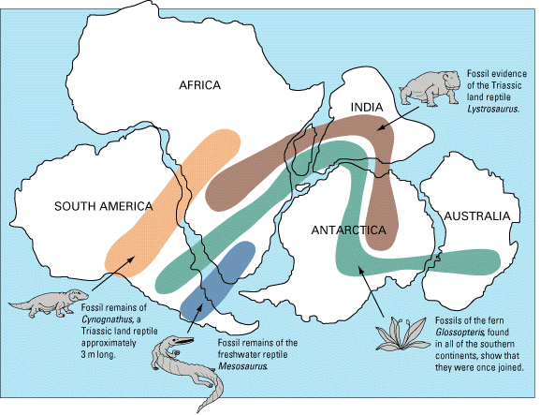
Continental separation
Requires massive forces
Needs an external source of force
Notes:
If the rock was indeed washed into the Mozambique Channel we have another problem -- where did the Mozambique Channel come from?
And the Mariana Trench?
Huge holes into which huge volumes of material have seeming disappeared?
And where did the water come from and where did it go?

Slide 10
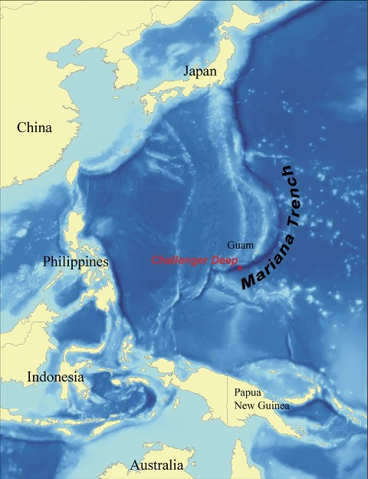
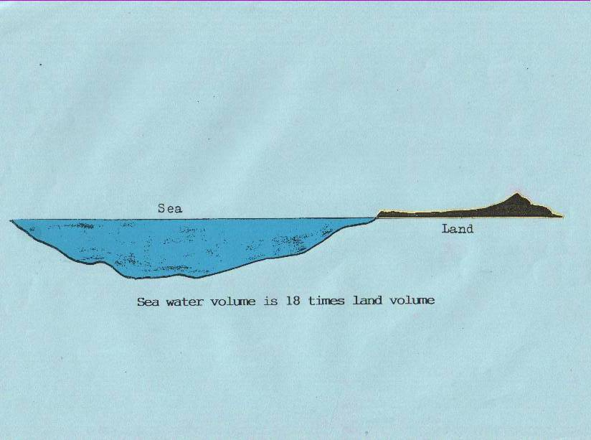
Ocean trenches
Another source of drainage
The Mariana Trench is 11,000 m deep
Volume of the seas MUCH greater (18x) volume of continents
Easy to postulate rapid and dramatic drainage
Notes:
If the rock was indeed washed into the Mozambique Channel we have another problem -- where did the Mozambique Channel come from?
And the Mariana Trench?
Huge holes into which huge volumes of material have seeming disappeared?
And where did the water come from and where did it go?

Slide 11
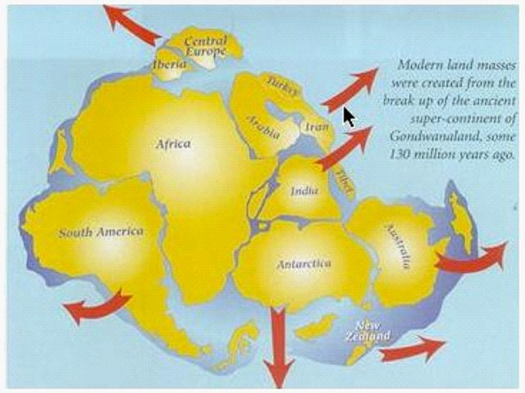
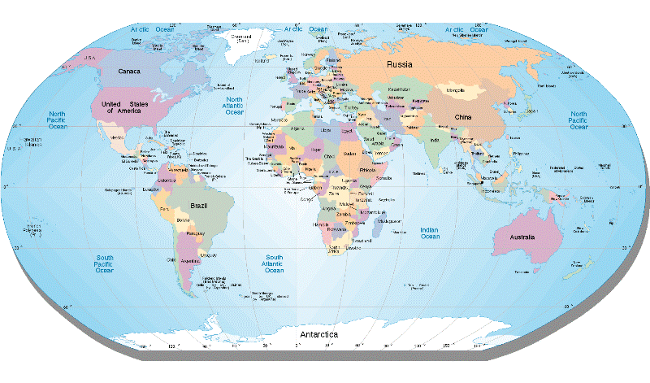
Continental separation
Hypothesis for displacement
But massive inertia and drag of continents
How were they moved such huge distances?
Mechanics requires a massive external force
Notes:
If the rock was indeed washed into the Mozambique Channel we have another problem -- where did the Mozambique Channel come from?
And the Mariana Trench?
Huge holes into which huge volumes of material have seeming disappeared?
And where did the water come from and where did it go?

Slide 12
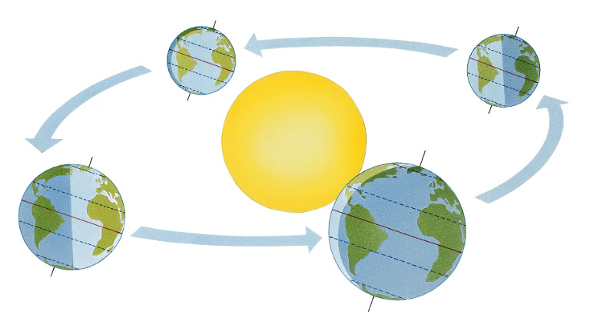
Continental separation
Hypothesis for displacement
Fly-by of large space object
Theories that earth’s axis was once
vertical
That orbit of sun was not elliptical
That a year was exactly 360 days
A large comet or other space object
that exerted massive gravitational
pull on the earth could pull the earth
out of a circular orbit around the sun
AND cause the earth to tilt on its axis, one theory says close to 30 degrees originally
WHY NOT?
Notes:
If the rock was indeed washed into the Mozambique Channel we have another problem -- where did the Mozambique Channel come from?
And the Mariana Trench?
Huge holes into which huge volumes of material have seeming disappeared?
And where did the water come from and where did it go?

Slide 13
Continental separation
Hypothesis for displacement
But, what about inertia?
Hysteresis – lag effect
The solid crust would respond immediately
The fluid, molten core would lag
Massive friction between the core and the crust
Just what would be needed to get the continents moving!
Notes:
If the rock was indeed washed into the Mozambique Channel we have another problem -- where did the Mozambique Channel come from?
And the Mariana Trench?
Huge holes into which huge volumes of material have seeming disappeared?
And where did the water come from and where did it go?

Slide 14
Continental separation
Hypothesis for displacement
One theory suggests that at the same time there was a reduction in internal gravitational force and the earth expanded significantly
Even if this did not happen it is possible to postulate upward vertical displacement of the continents as the ripping apart took place with the oceans being formed in cavities in the massive tears
Net effect?
Water drained off the continents at massive
speed giving rise to the massive erosion forms
that occur all over the earth
As noted before -- validate this theory against practical considerations
Notes:
If the rock was indeed washed into the Mozambique Channel we have another problem -- where did the Mozambique Channel come from?
And the Mariana Trench?
Huge holes into which huge volumes of material have seeming disappeared?
And where did the water come from and where did it go?

Slide 15
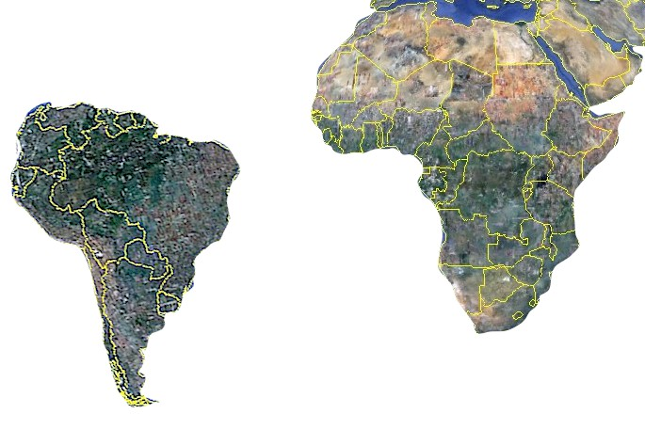
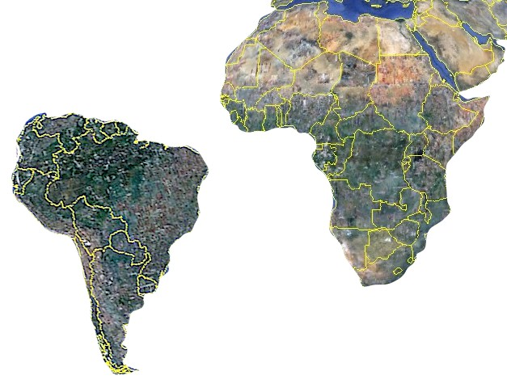
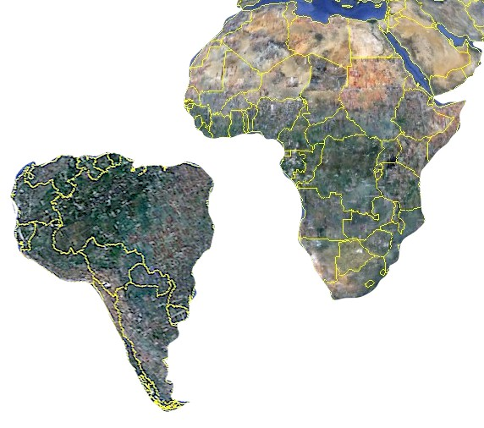
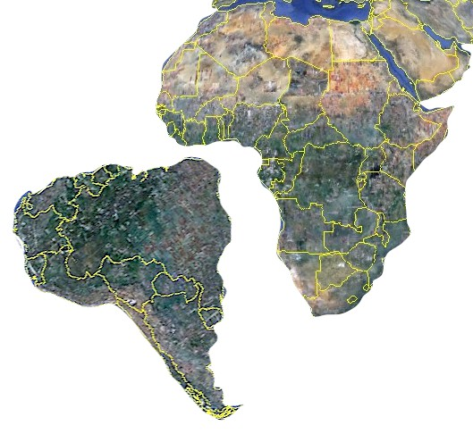
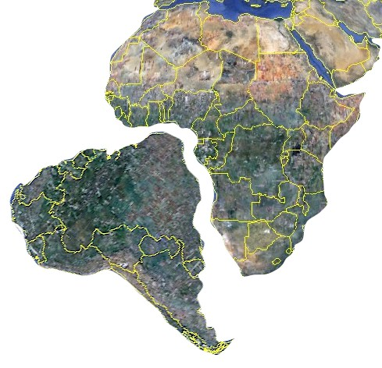
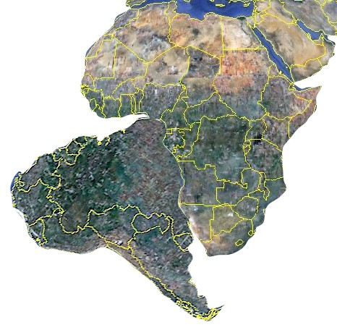
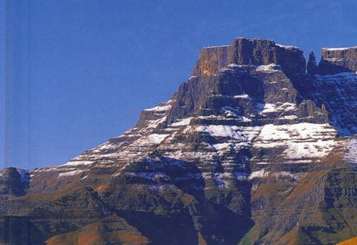
Continental separation
Hypothesis for rapid drainage
As continents separate massive gorges form
Water rushes off
the continents
Massive erosion beyond anything we can visualize occurs
Notes:
If the rock was indeed washed into the Mozambique Channel we have another problem -- where did the Mozambique Channel come from?
And the Mariana Trench?
Huge holes into which huge volumes of material have seeming disappeared?
And where did the water come from and where did it go?

Slide 16
The best theory I have encountered
This theory fits for me
It is entirely consistent with information reported by NASA in 2009 and 2010
It made sense to me the first time I heard it
I leave it to you to ponder and take a view on whether you have a better theory
It certainly works better for me than to suspend my engineering intellect and training and believe that all the things I have shown you happened gradually over millions or billions of years
Notes:
This theory fits for me
It made sense the first time i encountered it
I leave it to you to ponder and take a view on whether you have a better theory
It certainly works better for me than to suspend my engineering intellect and believe that all of the formations we have examined in this video were formed through incremental movements over millions or billions of years
Might also want to read “What is the orgin and purpose of man -- Creation versus Evolution” also on this DVD

Slide 17
Summing up
Steady state theories cannot explain what we have seen in this video
Massive external forces HAVE to have been applied
A massive external source of water seems essential
There ARE large chunks of ice in space
An astronomical object or “Ice Comet” seems to explain the situation
Is there a better theory?
I do not know one
What do YOU think?

Slide 18
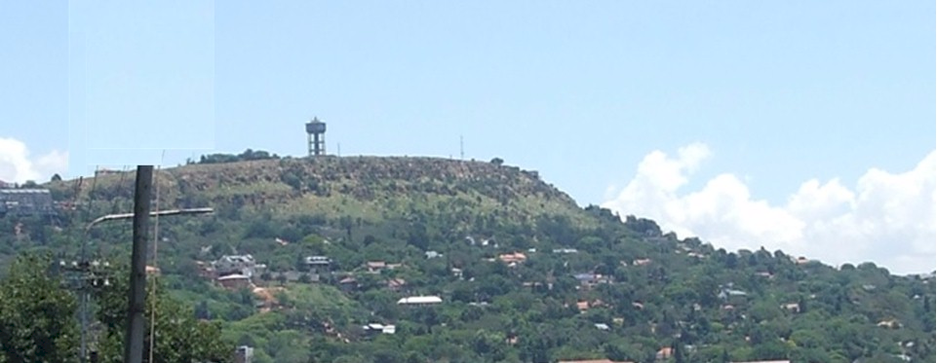
Turning history on its head
Massive evidence of a global flood
What does it all mean?
Continued in part 10
Summing up
Contact me James@ETI-Ministries.org Website www.ETI-Ministries.org

