Slide 1
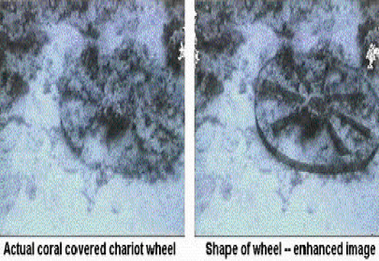
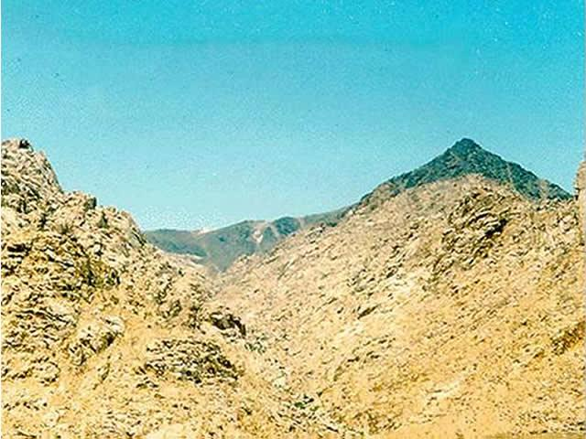
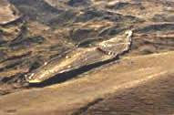
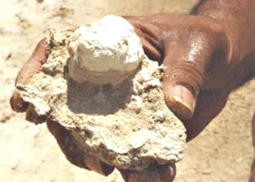

Turning history on its head
Massive evidence of a global flood
What does it all mean?
Part 8 – Signs of Judgment
Red Sea Crossing
Mount Sinai burned by fire
Sodom and Gomorrah
Burned with fire
Noah’s Ship / Ark
End Time Issue Ministries
Dr James A Robertson PrEng
Notes:
Northcliff again?

Slide 2
Overwhelming evidence of a global hydraulic and tectonic event
South African Gold Fields comprise sedimentary layers over 2 kilometers thick
Sedimentary rocks all over South Africa and all over the world speak of a massive flood event
Halfway House Granite Dome – molten rock upthrust by at least five kilometers
The top of the Dome sliced off level for thousands of kilometers
Massive erosion cutting deep valleys into the rock
All point to a massive hydraulic event
An ancient book (Genesis) confirms that this happened relatively recently (about 4,500 years ago)
Notes:
I believe the evidence is overwhelming
That there WAS a global flood and total destruction of the earth’s surface by water and tectonic events
In section 9 i will present a theory as to what actually happened in the physical world to cause this event, right now i want to take a detour into some softer issues
If what follows makes you uncomfortable you can jump to section 9 BUT i appeal to you NOT to jump and to sit through what follows no matter what existing opinions you may hold about the upcoming topic
The next critical question is whether this was a random event OR, as stated in the passage in the book commonly known as Genesis was this an act of judgment by the Creator
and have there been other judgments as outlined in Genesis, Exodus and other passages in the collection of human historical writings known as “the Bible”?
Then, there is an even bigger problem, given that there are passages in the bible that speak of judgment to come, are these in fact accurate
That there is ANOTHER judgment to come?
If that IS so, then we have important choices to make
That we HAVE a choice
There IS much error in the world today, see section 11 for an overview of some important truths and also see ebooks and other documents on the DVD

Slide 3
What if the Genesis account is reasonably accurate?
We have established that Genesis IS a reliable historical account to the extent that it reports a flood that destroyed the earth
What if Genesis is correct about the existence of a Creator as well?
What if Genesis is correct that this Almighty Creator judged mankind with the flood and forewarned a man called Noah to prepare a survival vessel in order to escape?
What if there is going to be another judgment and we are again being given advanced warning in order to escape?
Are you prepared?
Notes:
What if the account in Genesis is reasonably accurate?
What if there was a man called Noah or Nuh or whatever and he was saved with his family?
What if the Almighty really did speak to Noah and tell him to build a boat?
What if the Almighty DID trigger the events that caused a flood to occur?
A boat has been found in the right place
Images from Jonathan plus Google Earth
Archaeological finds support a family of eight and a flood and other corroborating information
I am fully satisfied that there WAS a flood and that it WAS a judgment and that there WERE ONLY eight people saved
And ALL human beings have descended from this one man with varying levels of DETERIORIATION
Refer the video and the books
JUDGMENT??
Or back luck?

Slide 4
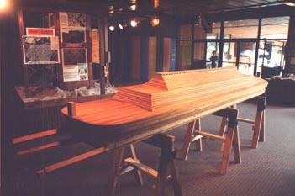
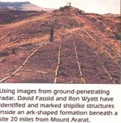
The ship (“Ark”) of Noah – found
Solid evidence of judgment
Genesis 6:5-8 “Then Yah the eternally self existing {the LORD} saw that the wickedness of man was great in the earth, and that every intent of the thoughts of his heart was only evil continually. And Yah the eternally self existing {the LORD} was sorry that He had made man on the earth, and He was grieved in His heart. So Yah the eternally self existing {the LORD} said, "I will destroy man whom I have created from the face of the earth, both man and beast, creeping thing and birds of the air, for I am sorry that I have made them.“ But Noah found grace in the eyes of Yah the eternally self
existing {the LORD}. “ NKJV
Notes:
The remains of Sodom and Gomorrah HAVE been found in the place identified
Image from Jonathan try and find on Google Earth refer the video
JUDGMENT? Or bad luck?

Slide 5
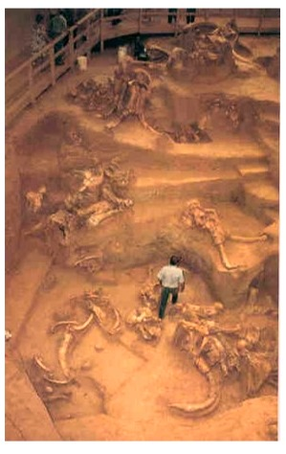
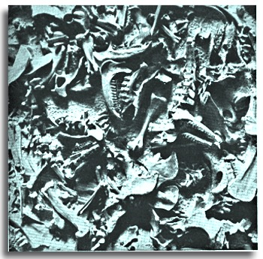
Other evidence
Fossil graveyards all over the earth

Slide 6
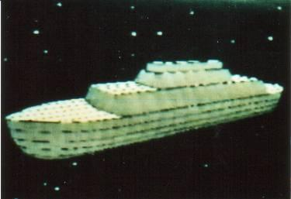
The ship (“Ark”) of Noah – found
Solid evidence of judgment
Genesis 6:13-17 “And the Almighty {God} said to Noah,"The end of all flesh has come before Me, for the earth is filled with violence through them; and behold, I will destroy them with the earth. Make yourself an ark (container) of gopherwood; make rooms in the ark, and cover it inside and outside with pitch. And this is how you shall make it: The length of the ark shall be three hundred cubits, its width fifty cubits, and its height thirty cubits. You shall make a window for the ark, and you shall finish it to a cubit from above; and set the door of the ark in its side. You shall make it with lower, second, and third decks. And behold, I Myself am bringing floodwaters on the earth, to destroy from under heaven all flesh in which is the breath of life; everything that is on the earth shall die.” NKJV
Notes:
The remains of Sodom and Gomorrah HAVE been found in the place identified
Image from Jonathan try and find on Google Earth refer the video
JUDGMENT? Or bad luck?

Slide 7
The ship (“Ark”) of Noah – found
Solid evidence of judgment
The existence of the ship evidences that the Creator warned Noah
If there was generally available evidence of a coming flood / ice object strike / fly-by that was capable of destroying the planet there would almost certainly have been other survivors
There is NO evidence of more than one survival vessel
There is no evidence of more than one
genealogy surviving
I take this as strong evidence that the
Creator did indeed speak to Noah
and that the flood WAS A JUDGMENT
Notes:
The remains of Sodom and Gomorrah HAVE been found in the place identified
Image from Jonathan try and find on Google Earth refer the video
JUDGMENT? Or bad luck?

Slide 8
Other signs of judgment
An army drowned in the Red Sea
Cities turned to Ash
A fire blackened mountain top
A split rock with erosion channels
Notes:
The remains of Sodom and Gomorrah HAVE been found in the place identified
Image from Jonathan try and find on Google Earth refer the video
JUDGMENT? Or bad luck?

Slide 9
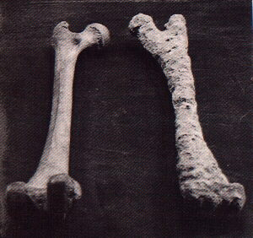
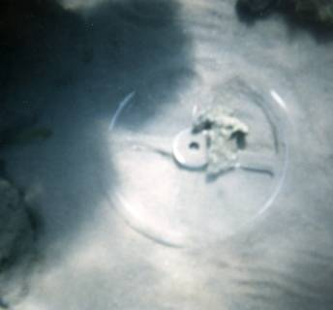
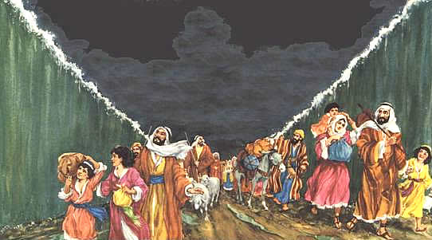
Drowning of an army in the Red Sea (about 1555BC) -- Exodus
Crossing site has been found
Where Exodus says it will be found
Remains of Chariots, horse and human skeletons and other artefacts found at this location
Notes:
Quote from Genesis about the flood – also later quotes?
Incidentally, the boat (Ark meaning container) has been found – artists impression of Ark from Jonathan or elsewhere

Slide 10
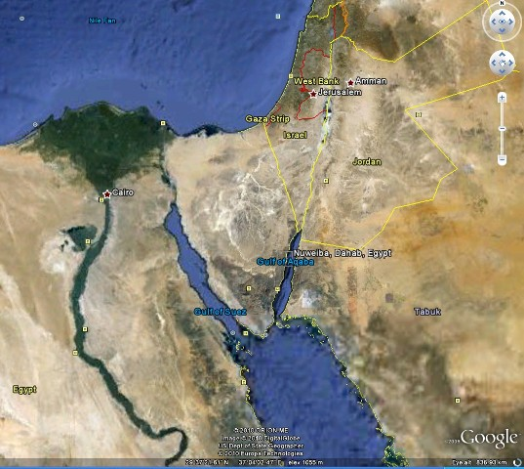
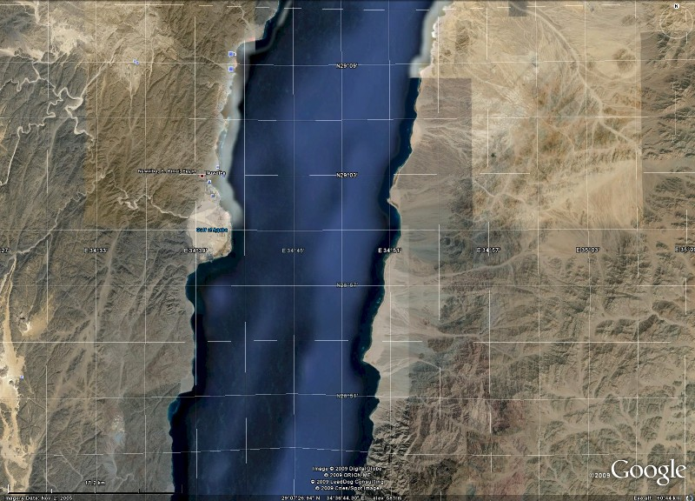
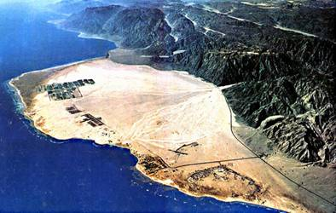
Drowning of an army in the Red Sea (about 1555BC) -- Exodus
Nuweiba
Gulf of Aqaba
Right hand branch of the Red Sea
Where Exodus positions the crossing site
Notes:
Quote from Genesis about the flood – also later quotes?
Incidentally, the boat (Ark meaning container) has been found – artists impression of Ark from Jonathan or elsewhere

Slide 11
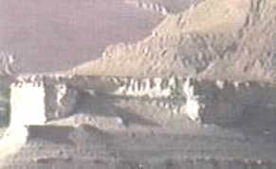
Soddom and Gomorrah turned to ash by brimstone (burning sulphur) -- Genesis
Brimstone – burning sulphur from the sky
Genesis 19:23-24 “The sun had risen upon the earth when Lot entered Zoar. Then Yah the eternally self existing {the LORD} rained brimstone and fire on Sodom and Gomorrah, from Yah the eternally self existing {the LORD} out of the heavens.” NKJV
Reduced to ash in exact location reported by Genesis
Notes:
Quote from Genesis about the flood – also later quotes?
Incidentally, the boat (Ark meaning container) has been found – artists impression of Ark from Jonathan or elsewhere

Slide 12
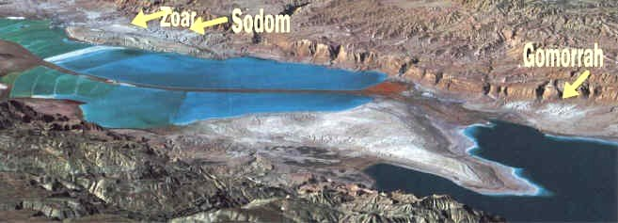
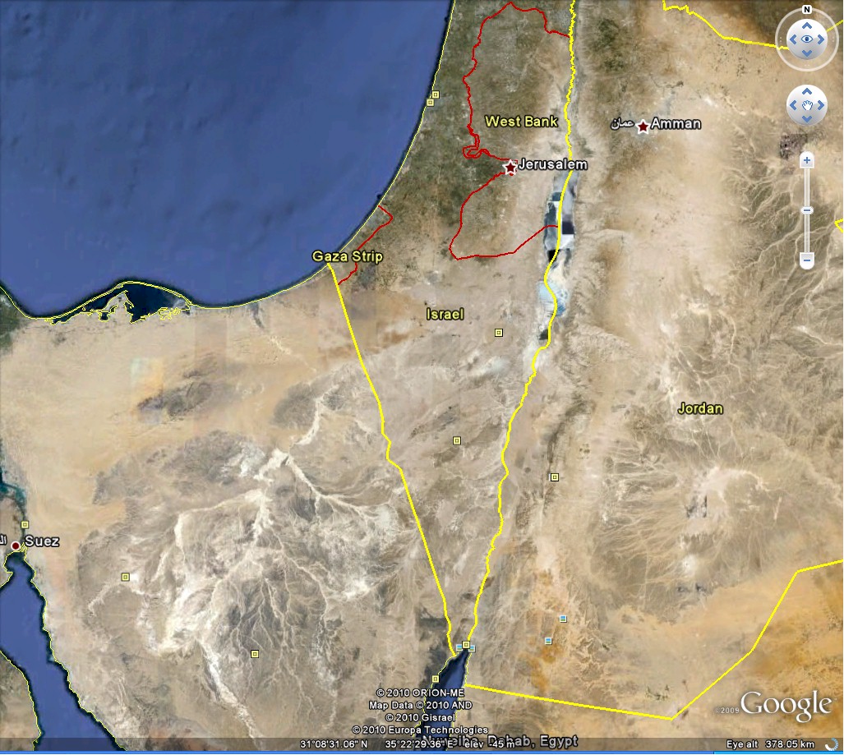
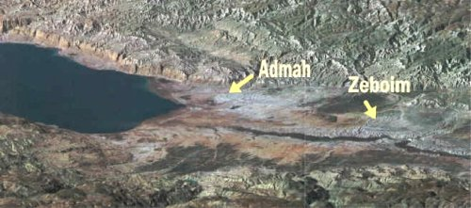
Sodom and Gomorrah turned to ash by brimstone
Next to Dead Sea in Israel
Aerial views
Notes:
Quote from Genesis about the flood – also later quotes?
Incidentally, the boat (Ark meaning container) has been found – artists impression of Ark from Jonathan or elsewhere

Slide 13
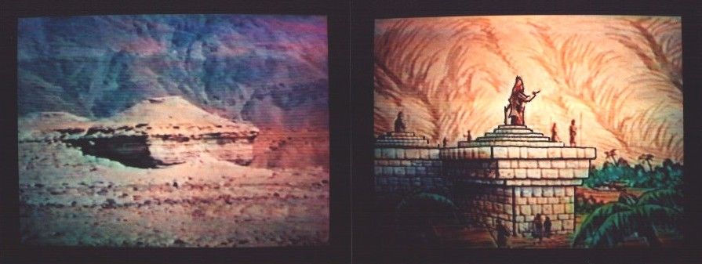
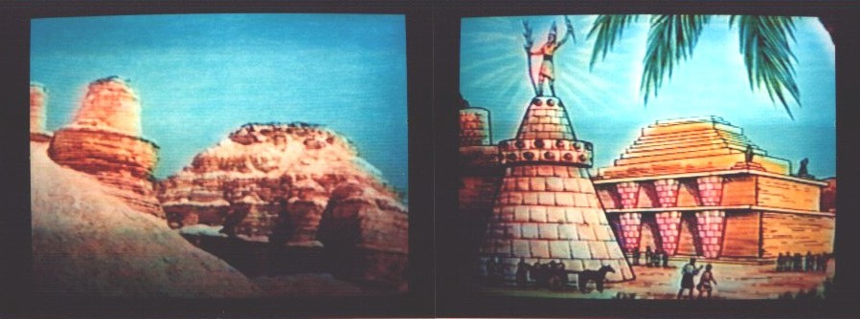
Soddom and Gomorrah turned to ash by brimstone
Actual photo on left
Artists reconstruction on right (Jim Pinkoski)
Notes:
Quote from Genesis about the flood – also later quotes?
Incidentally, the boat (Ark meaning container) has been found – artists impression of Ark from Jonathan or elsewhere

Slide 14
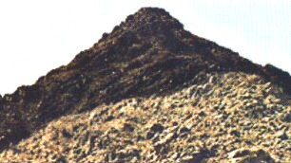
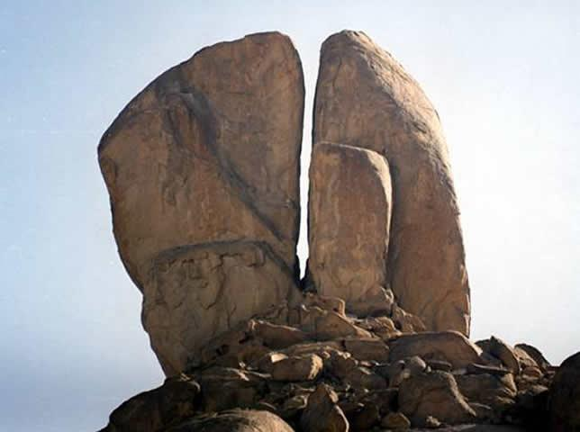
Split rock at Horeb and fire burned mountain (about 1555BC) -- Exodus
Split rock at Horeb with erosion channels as per Exodus 17:5-7
Fire blackened mountain as per Exodus 19:16-20
Notes:
Quote from Genesis about the flood – also later quotes?
Incidentally, the boat (Ark meaning container) has been found – artists impression of Ark from Jonathan or elsewhere

Slide 15
Mountain burned by fire
Exodus 19:16-20 “Then it came to pass on the third day, in the morning, that there were thunderings and lightnings, and a thick cloud on the mountain; and the sound of the trumpet was very loud, so that all the people who were in the camp trembled. And Moses brought the people out of the camp to meet with the Almighty {God}, and they stood at the foot of the mountain. Now Mount Sinai was completely in smoke, because Yah the eternally self existing {the LORD} descended upon it in fire. Its smoke ascended like the smoke of a furnace, and the whole mountain quaked greatly. And when the blast of the trumpet sounded long and
became louder and louder,
Moses spoke, and the Almighty
{God} answered him by voice.
Then Yah the eternally self existing
{the LORD} came down upon Mount
Sinai, on the top of the mountain.
And Yah the eternally self existing
the LORD} called Moses to the top
of the mountain, and Moses went
up.” NKJV
Notes:
Mountain burned by fire
And Ark of the Covenant
And tablets of stone
Image of Yahooshua on stake above Ark and blood on Mercy Seat – replace cross if possible? Or clarify that it was a stake – portion of tree trunk
Coming judgment and a basis for redemption

Slide 16
Ten laws spoken by the Almighty on the mountain
Exodus 20:1-6 "And the Almighty {God} spoke all these words, saying:
“I am Yah the eternally self existing {the LORD} your Mighty One {God}, who brought you out of the land of Egypt, out of the house of bondage. You shall have no other mighty ones {gods} before Me.
"You shall not make for yourself
a carved image -- any likeness of
anything that is in heaven above,
or that is in the earth beneath,
or that is in the water under the
earth; you shall not bow down to
them nor serve them.”" NKJV
Notes:
Mountain burned by fire
And Ark of the Covenant
And tablets of stone
Image of Yahooshua on stake above Ark and blood on Mercy Seat – replace cross if possible? Or clarify that it was a stake – portion of tree trunk
Coming judgment and a basis for redemption

Slide 17
Ten laws spoken by the Almighty on the mountain
Exodus 20:7-10 ““3. You shall not take the name of Yah the eternally self existing {the LORD} your Mighty One {God} in vain, for Yah the eternally self existing {the LORD} will not hold him guiltless who takes His name in vain.
4. "Remember the Sabbath day (Saturday), to keep it holy. 9 Six days you shall labor and do all your work, 10 but the seventh day is the Sabbath of Yah the eternally self
existing {the LORD} your Mighty
One {God}. In it you shall do no
work: you, nor your son, nor your
daughter, nor your male servant,
nor your female servant, nor your
cattle, nor your stranger who is
within your gates.””
Notes:
Mountain burned by fire
And Ark of the Covenant
And tablets of stone
Image of Yahooshua on stake above Ark and blood on Mercy Seat – replace cross if possible? Or clarify that it was a stake – portion of tree trunk
Coming judgment and a basis for redemption

Slide 18
Ten laws spoken by the Almighty on the mountain
Exodus 20:12-17 “”5. Honor your father and your mother, that your days may be long upon the land which Yah the eternally self existing {the LORD} your Mighty One {God} is giving you.
6. "You shall not murder.
7. "You shall not commit adultery.
8. "You shall not steal.
9. "You shall not bear false witness
against your neighbor.
10 "You shall not covet your neighbor's
house; you shall not covet your
neighbor's wife, nor his male
servant, nor his female servant,
nor his ox, nor his donkey,
nor anything that is your neighbor's."“
NKJV
Notes:
Mountain burned by fire
And Ark of the Covenant
And tablets of stone
Image of Yahooshua on stake above Ark and blood on Mercy Seat – replace cross if possible? Or clarify that it was a stake – portion of tree trunk
Coming judgment and a basis for redemption

Slide 19
Ten laws spoken by the Almighty on the mountain
Only time in recorded history that the Almighty Creator has appeared in a manifest form and spoken to millions of people
Accordingly, what was said there should be viewed as extremely important
The Ten Laws or
Commandments are therefore
the MOST IMPORTANT laws
ever given
Notes:
Mountain burned by fire
And Ark of the Covenant
And tablets of stone
Image of Yahooshua on stake above Ark and blood on Mercy Seat – replace cross if possible? Or clarify that it was a stake – portion of tree trunk
Coming judgment and a basis for redemption

Slide 20
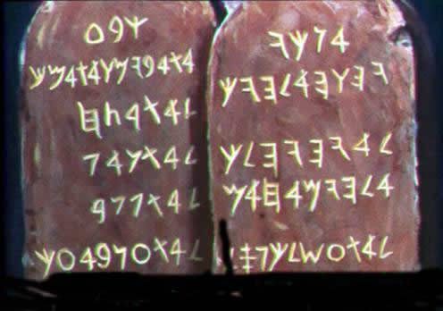
Mountain burned by fire, ten commandments, tablets of stone
Exodus 24:12 "Then Yah the eternally self existing {the LORD} said to Moses,"Come up to Me on the mountain and be there; and I will give you tablets of stone, and the law and commandments which I have written, that you may teach them." NKJV
Artists Impression
Notes:
Mountain burned by fire
And Ark of the Covenant
And tablets of stone
Image of Yahooshua on stake above Ark and blood on Mercy Seat – replace cross if possible? Or clarify that it was a stake – portion of tree trunk
Coming judgment and a basis for redemption

Slide 21
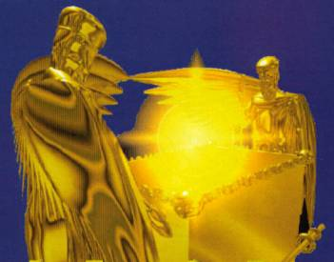
Mountain burned by fire, ten commandments, tablets of stone, Ark (container) of the Covenant
Deuteronomy 10:3-5 “"So I [Moses] made an ark of acacia wood, hewed two tablets of stone like the first, and went up the mountain, having the two tablets in my hand. 4 And He wrote on the tablets according to the first writing, the Ten Commandments, which Yah the eternally self existing {the LORD} had spoken to you in the mountain from the midst of the fire in the day of the assembly; and Yah the eternally self existing {the LORD} gave them to me. 5 Then I turned and came down from the mountain, and put the tablets in the ark which I had made; and there they are, just as Yah the eternally self existing
{the LORD} commanded me.”“ NKJV
1 Kings 8:9 “Nothing was in the ark
except the two tablets of stone
which Moses put there at Horeb,
when Yah the eternally self existing
{the LORD} made a covenant with
the children of Israel, when they
came out of the land of Egypt.” NKJV
Artists Impression
Notes:
Mountain burned by fire
And Ark of the Covenant
And tablets of stone
Image of Yahooshua on stake above Ark and blood on Mercy Seat – replace cross if possible? Or clarify that it was a stake – portion of tree trunk
Coming judgment and a basis for redemption

Slide 22
Ark (container) of the Covenant
Hidden about 597 BC
Ark of the covenant
Container of the terms of the covenant
The ten laws (commandments)
The basis of judgment
Break the covenant you DIE
But, it went missing about 587 BC at the
time of the exile from Jerusalem
to Babylon
Notes:
Skeletons, chariot parts, etc have been found in the Red Sea, where Exodus says they are
Nuweiba, Google Earth, images from Jonathan
JUDGMENT? Or bad luck

Slide 23
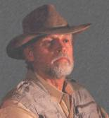
Ark of the Covenant found in 1982 AD by Ron Wyatt
Evidence of coming judgment
Hidden in an excavated cave
Outside the walls of Jerusalem
Under a hill called “skull hill” because it looks like a skull Matthew 27:33, Mark 15:22 and John 19:17
Six meters under an execution {crucifixion} site that bears close resemblance to that described in the books of Matthew, Mark, Luke and John
With an earthquake crack (Matthew 27:54) that cuts through the middle stake {cross} hole
And blood with only the female chromosome has flowed down the crack onto the Mercy Seat of the Ark
This is huge if you get the real significance
Notes:
Skeletons, chariot parts, etc have been found in the Red Sea, where Exodus says they are
Nuweiba, Google Earth, images from Jonathan
JUDGMENT? Or bad luck

Slide 24
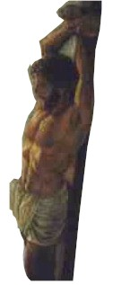
Ark (container) of the Covenant
Found about 1982 AD by Ron Wyatt evidence of coming judgment
Close correlation with the four historical accounts that deal with the death of a prophet commonly known as Jesus Christ
Actual name Yahooshua meaning “Yah (the Almighty) is salvation”
Christ meaning “anointed with the Spirit of Yah”
Anointing refers to the presence of the Spirit of Yah on a human being metaphorically compared with smearing with oil
Died on a stake (tree trunk) NOT a cross (the cross is a demonic sign = Ankh = pornographic symbol)
Notes:
Skeletons, chariot parts, etc have been found in the Red Sea, where Exodus says they are
Nuweiba, Google Earth, images from Jonathan
JUDGMENT? Or bad luck

Slide 25
Ark (container) of the Covenant
Found about 1982 AD by Ron Wyatt
Evidence of coming judgment
It had to be this way
Blood on the Mercy Seat of the Ark is necessary for any offering {sacrifice} for atonement to have validity (Leviticus 16)
Necessary for a new Covenant
Necessary for a new way of responding to the threat of coming judgment
Videos (DVD), books and other material available from admin@ETIMin.org graysales@bigpond.com and other sources
Requires careful consideration
Notes:
Skeletons, chariot parts, etc have been found in the Red Sea, where Exodus says they are
Nuweiba, Google Earth, images from Jonathan
JUDGMENT? Or bad luck

Slide 26
Signs of Judgement
Flood and the ship of Noah
Fire blackened mountain
Execution {Crucifixion} site with earthquake crack
Ark of the Covenant with blood on the Mercy Seat
Tablets of stone with Ten Laws (Commandments) engraved
A basis for careful introspection and self examination
Notes:
Skeletons, chariot parts, etc have been found in the Red Sea, where Exodus says they are
Nuweiba, Google Earth, images from Jonathan
JUDGMENT? Or bad luck

Slide 27
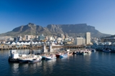
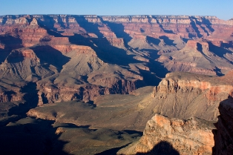
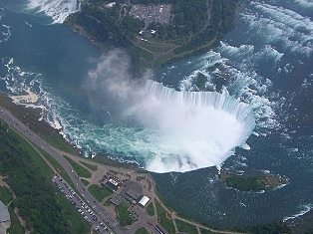
Northcliff – the flood – a sign of Judgment
Massive tectonic upheaval
Massive depths of water
Massive water action laying down sediments
Massive dome up-thrusting earth’s surface
Massive water action cutting the top off the dome
Massive water action cutting the valleys into the dome
In fact – almost anywhere you go on earth you are SURROUNDED BY SIGNS OF JUDGMENT!
ARE you prepared like Noah?
OR …?
Notes:
Skeletons, chariot parts, etc have been found in the Red Sea, where Exodus says they are
Nuweiba, Google Earth, images from Jonathan
JUDGMENT? Or bad luck

Slide 28
IS there another judgment?
Or is this all history?
Should you be concerned at all this?
Or is it just history and nothing to worry about?
Did Yahooshua live and die to warn of judgment to come
And provide a means for you to escape judgment to come?
Or was he just any man executed by the Roman Authorities of his time?
Notes:
List the ten commandments with correct wording as i have them
BASIS OF JUDGMENT

Slide 29
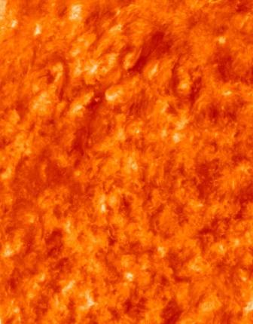
Indications of coming judgment
Revelation 20:11-15 “Then I saw a great white throne and Him who sat on it, from whose face the earth and the heaven fled away. And there was found no place for them. And I saw the dead, small and great, standing before the Almighty {God}, and books were opened. And another book was opened, which is the Book of Life. And the dead were judged according to their works, by the things which were written in the books. The sea gave up the dead who were in it, and Death and Hades delivered up the dead who were in them. And they were judged, each one according to his works. Then Death and Hades were cast into the lake of fire. This is the second death. And anyone not found written in the Book of Life was cast into the lake of fire.” NKJV
Revelation 21:5-8 “And He said to me,"It is done! I am the Alpha and the Omega, the Beginning and the End. I will give of the fountain of the water of life freely to him who thirsts. He who overcomes shall inherit all things, and I will be his Mighty One {God} and he shall be My son. But the cowardly, unbelieving, abominable, murderers, sexually immoral, sorcerers, idolaters, and all liars shall have their part in the lake which burns with fire and brimstone, which is the second death.“ NKJV
Notes:
Quote Yahooshua and one or two others, also Revelation
Revelation 21:8, lake of fire
Thrones, overcome
Quotes weeping and wailing, etc
Basis is 10 commandments
Read “Where will YOU spend eternity?” – image of document or create a book cover and publish

Slide 30
Indications of coming judgment spoken by Yahooshua {Jesus}
Matthew 7:21-23 – Yahooshua speaking “"Not everyone who says to Me,'Lord, Lord,' shall enter the kingdom of heaven, but he who does the will of My Father in heaven. Many will say to Me in that day, 'Lord, Lord, have we not prophesied in Your name, cast out demons in Your name, and done many wonders in Your name?' 23 And then I will declare to them, 'I never knew you; depart from Me, you who practice lawlessness!’”
Matthew 13:41-43 – Yahooshua speaking “The Son of Man will send out His angels, and they will gather out of His kingdom all things that offend, and those who practice lawlessness, and will cast them into the furnace of fire. There will be wailing and gnashing of teeth. Then the righteous will shine forth as the sun in the kingdom of their Father. He who has ears to hear, let him hear!”
Matthew 25:41 – Yahooshua speaking “"Then He will also say to those on the left hand,'Depart from Me, you cursed, into the everlasting fire prepared for the devil and his angels:”
Notes:
Quote Yahooshua and one or two others, also Revelation
Revelation 21:8, lake of fire
Thrones, overcome
Quotes weeping and wailing, etc
Basis is 10 commandments
Read “Where will YOU spend eternity?” – image of document or create a book cover and publish

Slide 31
Indications of coming judgment
Mark 9:43-44 - Yahooshua speaking “to go to hell, into the fire that shall never be quenched -- where 'Their worm does not die And the fire is not quenched.‘”
Luke 12:49 – Yahooshua speaking “I came to send fire on the earth, and how I wish it were already kindled!”
1 Corinthians 3:13-15 “each one's work will become clear; for the Day will declare it, because it will be revealed by fire; and the fire will test each one's work”
2 Peter 3:12 “looking for and hastening the coming of the day of the Almighty, because of which the heavens will be dissolved, being on fire, and the elements will melt with fervent heat?” NKJV
Notes:
Quote Yahooshua and one or two others, also Revelation
Revelation 21:8, lake of fire
Thrones, overcome
Quotes weeping and wailing, etc
Basis is 10 commandments
Read “Where will YOU spend eternity?” – image of document or create a book cover and publish

Slide 32
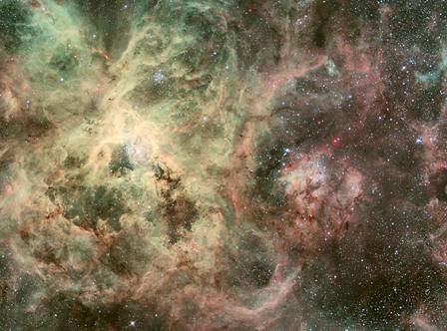
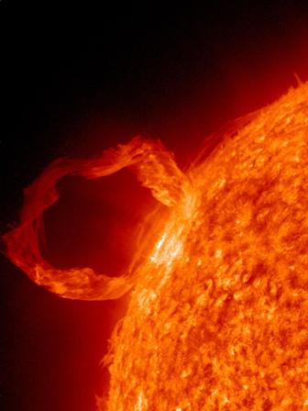
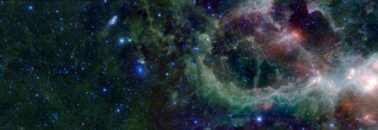
Indications of coming judgment
Eternal fire is entirely plausible
Millions of suns
Notes:
Quote Yahooshua and one or two others, also Revelation
Revelation 21:8, lake of fire
Thrones, overcome
Quotes weeping and wailing, etc
Basis is 10 commandments
Read “Where will YOU spend eternity?” – image of document or create a book cover and publish

Slide 33

There are ALSO alleged to be great rewards
Revelation 21:6-7 “He who overcomes shall inherit all things, and I will be his Mighty One {God} and he shall be my son.”
Revelation 2:7 “To him who overcomes I will give to eat from the tree of life, which is in the midst of the Paradise of Yah {God}."'
Revelation 2:11 “He who overcomes shall not be hurt by the second death.””
Revelation 2:26 “And he who overcomes, and keeps My works until the end, to him I will give power over the nations”
Revelation 3:5 “He who overcomes shall be clothed in white garments, and I will not blot out his name from the Book of Life”
Revelation 3:21 “To him who overcomes I will grant to sit with Me on My throne,” NKJV
Notes:
This could be the most important decision you ever make
Please give it serious consideration
Consider also that if there can be such great error that flies in the face of such “in your face” evidence of a global flood as we have looked at in this presentation, how much more likely is it that there can be error in all sorts of other areas of teaching

Slide 34
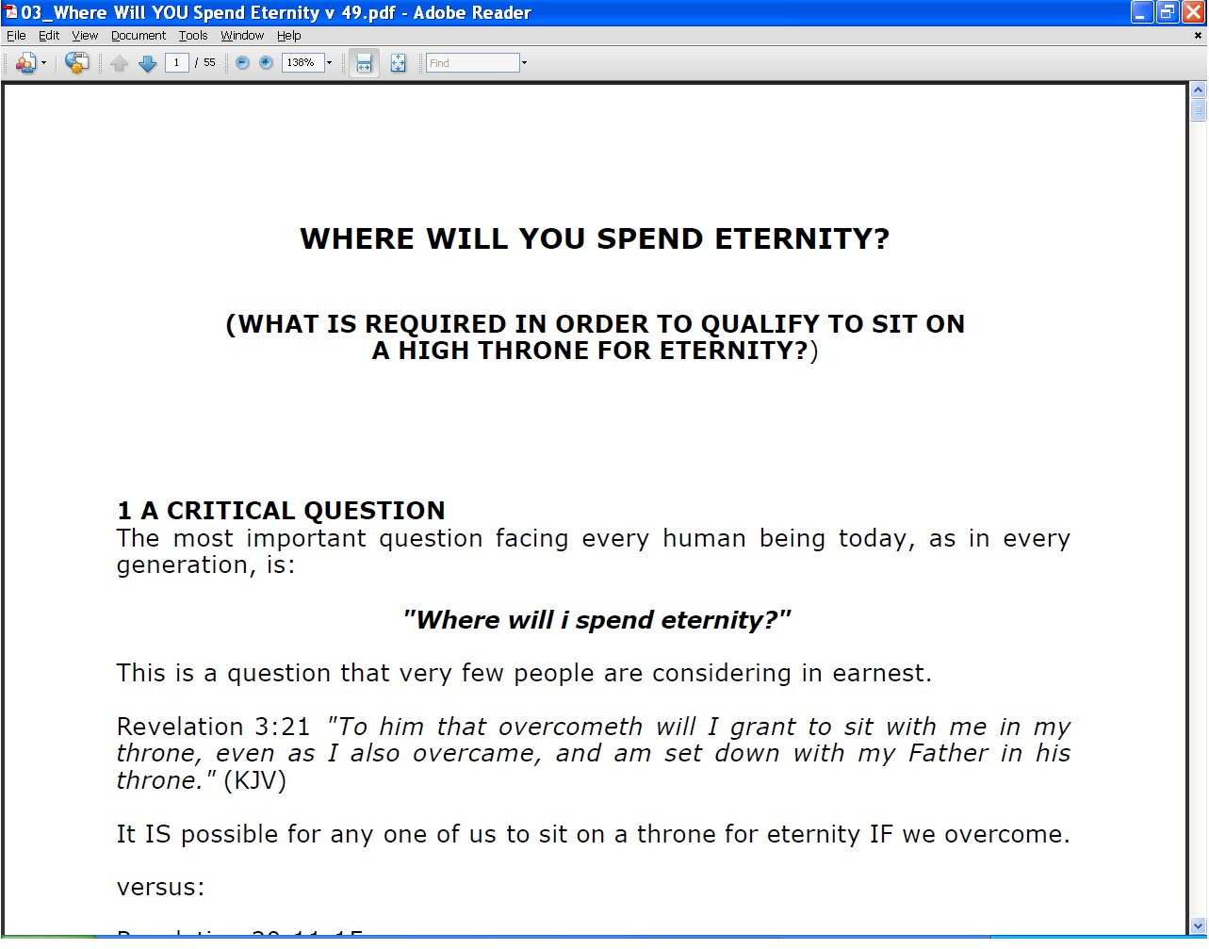
Where will YOU spend eternity?
On the CD with this DVD set or www.ETIMin.org
In depth analysis of the book relating to coming judgement
The basis of judgment
The continuum from the deepest part of the lake of fire to the highest thrones in heaven
The guidelines that are given as to how to be favourably rated on the Day of Judgment
Vital reading if you have in any way been constructively challenged by this presentation to seek a close walk with the Almighty Creator
I regard this document as the most important item I have ever written and I have written thousands of documents
Notes:
This could be the most important decision you ever make
Please give it serious consideration
Consider also that if there can be such great error that flies in the face of such “in your face” evidence of a global flood as we have looked at in this presentation, how much more likely is it that there can be error in all sorts of other areas of teaching

Slide 35
If you are not sure, ponder!
If you have never considered the possibility of a judgment in which you will participate the last few slides are potentially highly challenging
If you claim to believe in some way and have not realized that YOU face judgment, the same comment applies
If you have known there is a judgment and that you will participate but have not realized that you can still face outer darkness or a high throne or anything in between the same applies
Ultimately there is nothing more important than where you will spend eternity
I hope that this presentation has challenged you on this ☺
Notes:
This could be the most important decision you ever make
Please give it serious consideration
Consider also that if there can be such great error that flies in the face of such “in your face” evidence of a global flood as we have looked at in this presentation, how much more likely is it that there can be error in all sorts of other areas of teaching

Slide 36
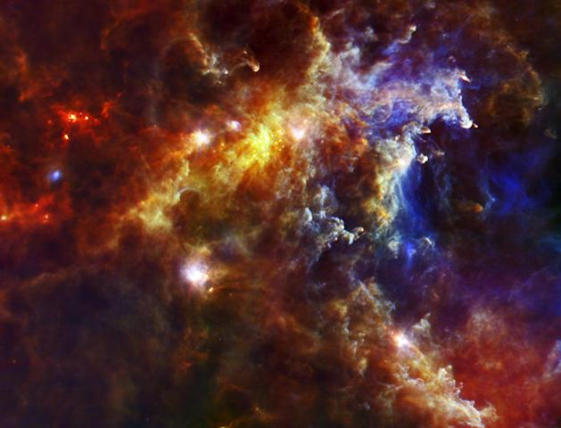
Summing up
There WAS a global flood
There IS a creator
There WILL be a Day of Judgment
There IS a lake of fire
There IS a place of beauty with thrones for eternity
AND we have a CHOICE about how we live our lives
I leave you to reflect on your beliefs and see if they fall into the same category as believing in steady state conditions on earth for millions or billions of years in an unstable Universe
Notes:
Curve from the pit to the throne

Slide 37
A prayer of repentance if you believe but are not prepared for judgment
Father I come to you in the name of Yahooshua
I now recognize that there is a judgment to come and that I will participate in it
I am not prepared
I ask you to forgive my error and forgive my sin in the name of Yahooshua
I ask you to lead me and guide me to prepare myself in order that I may overcome in the days ahead and be found a good and faithful servant on the Day of Judgment
Amen
Contact James@ETIMin.org for support and more information
Notes:
See notes from December 2010

Slide 38
A prayer if you have not previously believed
Father I come to you in the name of Yahooshua
I recognize that I have not previously believed in your existence but that you do indeed exist
I ask you to forgive my sins in the name of Yahooshua and to give me another chance
I ask you to guide me in all things and particularly to help me to find the material I need to read, hear, etc and to meet people who can help me
Help me to overcome to the end that I may be found a good and faithful servant
Amen
Contact James@ETIMin.org for support and more information
Notes:
See notes from December 2010

Slide 39
Some useful points to pray
Father please bring the people you want into my life and take the people you do not want out
Open the eyes of my understanding to see what you want me to see and close my eyes to what you do not want me to see
Open my ears to hear what you want me to hear and close my ears to what you do not want me to hear
Help me to speak only what you want me to speak and to refrain from saying those things that are not appropriate or not pleasing to you
Lead me in every possible way and teach me to be led by Your Spirit
Fill me with your Spirit and let the fire of your Spirit burn out all in my life that is not pleasing to you
Speak to me in whatever way I can hear you through books, CD’s, DVD’s, the Internet, email, radio, TV, through people I meet or in any other way I am able to hear you
Help me to be sensitive to your leading and help me to know you more day by day
Notes:
See notes from December 2010

Slide 40
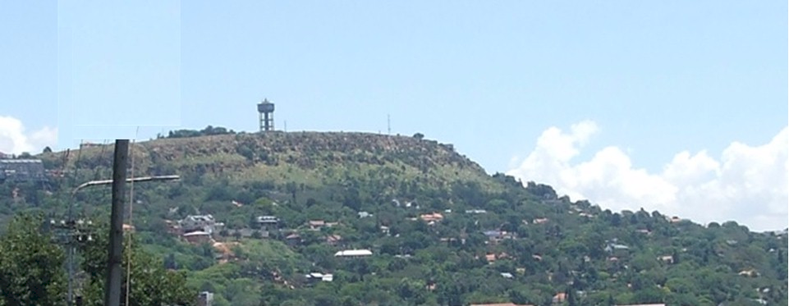
Turning history on its head
Massive evidence of a global flood
What does it all mean?
Continued in part 9
Where did the water come from?
and where did it go?
Contact me James@ETI-Ministries.org Website www.ETI-Ministries.org

