Slide 1
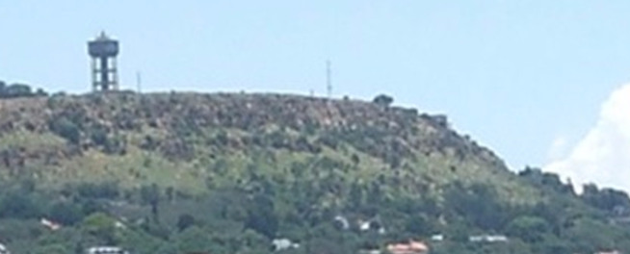
Turning history on its head
Massive evidence of a global flood
What does it all mean?
Part 5 – The African Erosion Surface
End Time Issue Ministries
Dr James A Robertson PrEng
Notes:
Find a panorama that shows this well
Preferably from Northcliff looking north, have several just pick the best
– camera image next to Northcliff
Superimpose horizontal line, spirit level, missing dome section, layers on top

Slide 2
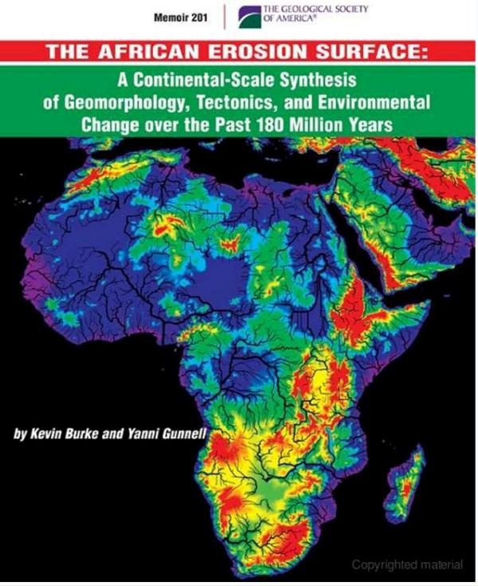
The African Erosion Surface A massive flat plane
Widely recognized
1,980,000 exact matches in Google for “African Erosion Surface”
Considerable technical literature
Vital to understanding the full impact of this presentation
How did it happen?
Notes:
Refer to map in paper off the Internet
Map from my Atlas – scan
Map of Johannesburg / Gauteng – not too detailed
Panorama’s
Northcliff, Voortrekker Monument, Grand Central Airport?, Primrose, Kraft Road, Koster, Swartruggens
Rotate each panorama to level view
Rotate till level??
Put a Spirit level on the image

Slide 3
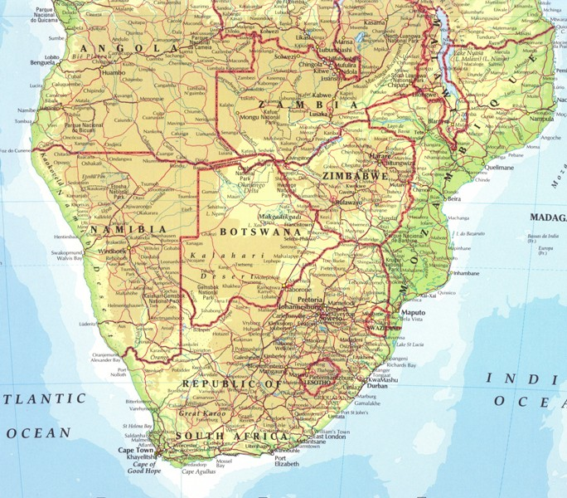
The African Erosion Surface
All the medium brown areas
A very large part of Southern Africa
Notes:
Refer to map in paper off the Internet
Map from my Atlas – scan
Map of Johannesburg / Gauteng – not too detailed
Panorama’s
Northcliff, Voortrekker Monument, Grand Central Airport?, Primrose, Kraft Road, Koster, Swartruggens
Rotate each panorama to level view
Rotate till level??
Put a Spirit level on the image

Slide 4
Panorama North from Northcliff
West
North
East
Almost exactly uniform and level horizon
Same panorama characteristics all over the Witwatersrand, Gauteng and beyond
Notes:
Refer to map in paper off the Internet
Map from my Atlas – scan
Map of Johannesburg / Gauteng – not too detailed
Panorama’s
Northcliff, Voortrekker Monument, Grand Central Airport?, Primrose, Kraft Road, Koster, Swartruggens
Rotate each panorama to level view
Rotate till level??
Put a Spirit level on the image

Slide 5
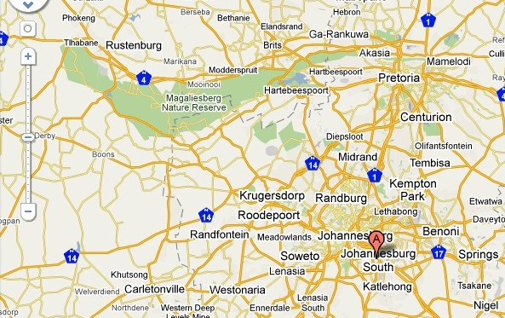
Panorama North from Northcliff
Notes:
Refer to map in paper off the Internet
Map from my Atlas – scan
Map of Johannesburg / Gauteng – not too detailed
Panorama’s
Northcliff, Voortrekker Monument, Grand Central Airport?, Primrose, Kraft Road, Koster, Swartruggens
Rotate each panorama to level view
Rotate till level??
Put a Spirit level on the image

Slide 6
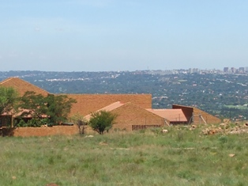
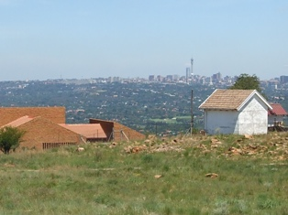
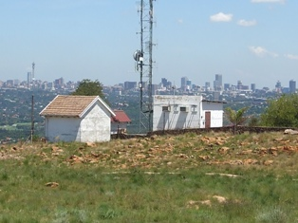
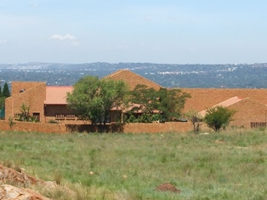
Panorama South from Northcliff
South - East
South
Notes:
Refer to map in paper off the Internet
Map from my Atlas – scan
Map of Johannesburg / Gauteng – not too detailed
Panorama’s
Northcliff, Voortrekker Monument, Grand Central Airport?, Primrose, Kraft Road, Koster, Swartruggens
Rotate each panorama to level view
Rotate till level??
Put a Spirit level on the image

Slide 7
Panorama South from Northcliff
Notes:
Refer to map in paper off the Internet
Map from my Atlas – scan
Map of Johannesburg / Gauteng – not too detailed
Panorama’s
Northcliff, Voortrekker Monument, Grand Central Airport?, Primrose, Kraft Road, Koster, Swartruggens
Rotate each panorama to level view
Rotate till level??
Put a Spirit level on the image

Slide 8
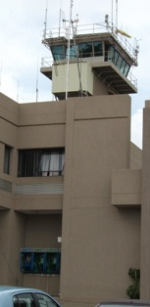
Panorama from Grand Central Airport Control Tower
South
West
North
East
South
Image shows curvature of the earth
No high points above the uniform level line on the horizon
Notes:
Refer to map in paper off the Internet
Map from my Atlas – scan
Map of Johannesburg / Gauteng – not too detailed
Panorama’s
Northcliff, Voortrekker Monument, Grand Central Airport?, Primrose, Kraft Road, Koster, Swartruggens
Rotate each panorama to level view
Rotate till level??
Put a Spirit level on the image

Slide 9
Panorama from Grand Central Airport Control Tower

Slide 10
Panorama from East of Koster North West Province
West
North
East
South
West
Image shows curvature of the earth
No high points above the uniform level line on the horizon
Notes:
Refer to map in paper off the Internet
Map from my Atlas – scan
Map of Johannesburg / Gauteng – not too detailed
Panorama’s
Northcliff, Voortrekker Monument, Grand Central Airport?, Primrose, Kraft Road, Koster, Swartruggens
Rotate each panorama to level view
Rotate till level??
Put a Spirit level on the image

Slide 11
Panorama from East of Koster North West Province

Slide 12
Panorama from top of N14 approach to Krugersdorp
North East
East
South East
Image shows curvature of the earth
No high points above the uniform level line on the horizon
Note 30 degree dip of rock in cutting to the right of the picture
Notes:
Refer to map in paper off the Internet
Map from my Atlas – scan
Map of Johannesburg / Gauteng – not too detailed
Panorama’s
Northcliff, Voortrekker Monument, Grand Central Airport?, Primrose, Kraft Road, Koster, Swartruggens
Rotate each panorama to level view
Rotate till level??
Put a Spirit level on the image

Slide 13
Panorama from top of N14 approach to Krugersdorp

Slide 14
Areas covered by panorama’s and everywhere else you look

Slide 15
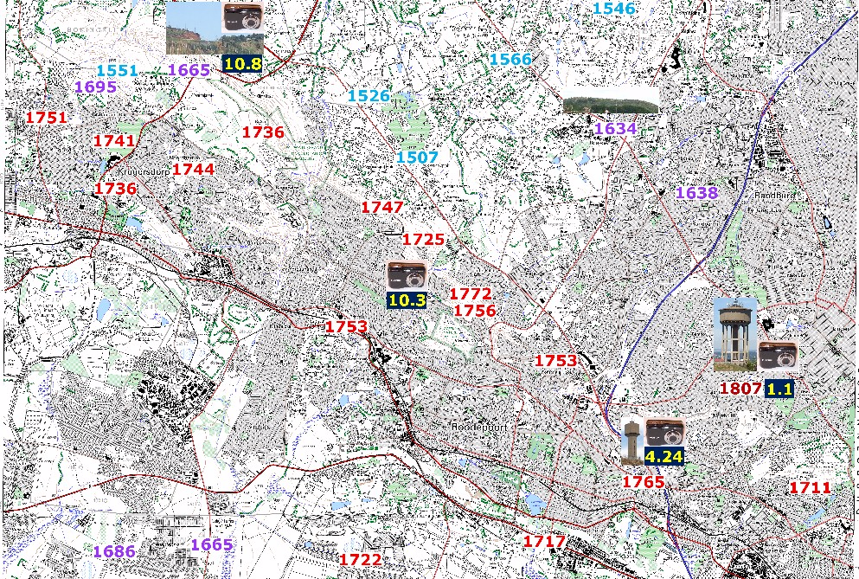
Spot heights on maps 1 in 50,000 Ordinance Survey Map 2627BB Northcliff
Notes:
Spot heights on a couple of 1:50,000 maps to make the point – drill down and scan from one point to the next in high resolution, tie in to Google Maps if it adds value

Slide 16
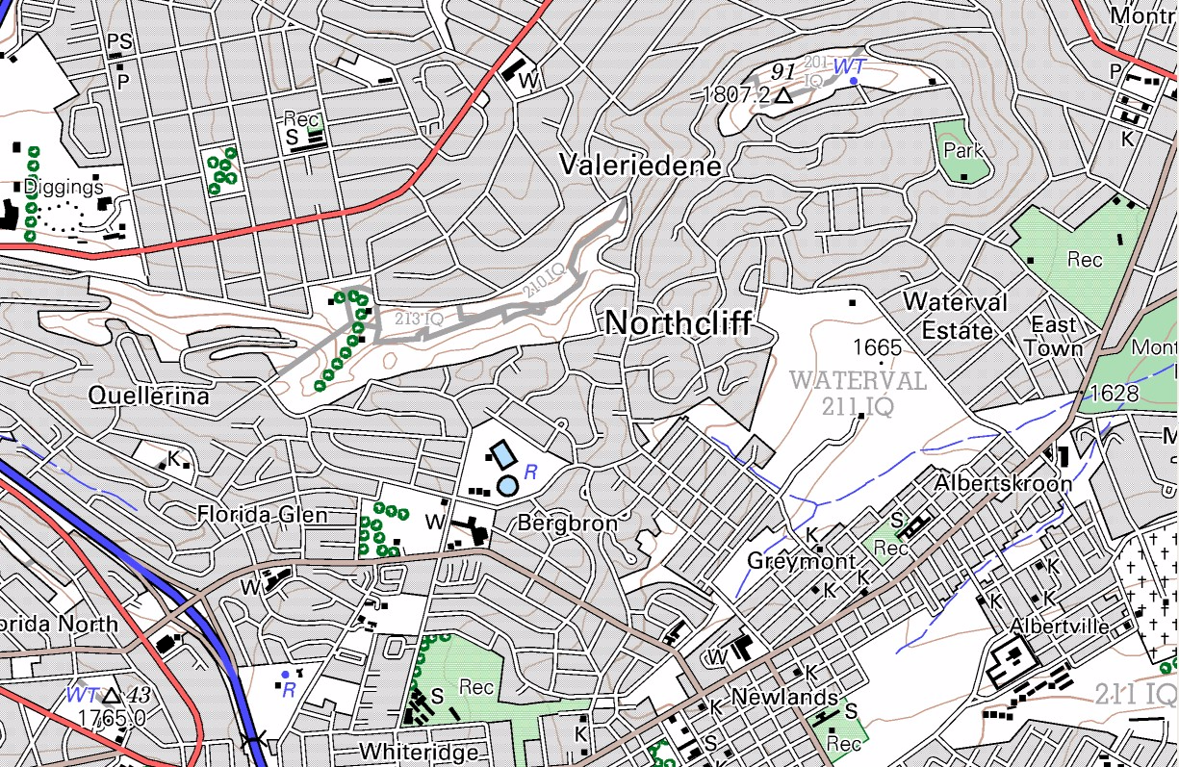
Spot heights on 1 in 50,000 maps 2627BB Roodepoort -- Northcliff 1,807m above sea level (ASL)
2.3% lower than Northcliff
Notes:
Spot heights on a couple of 1:50,000 maps to make the point – drill down and scan from one point to the next in high resolution, tie in to Google Maps if it adds value

Slide 17
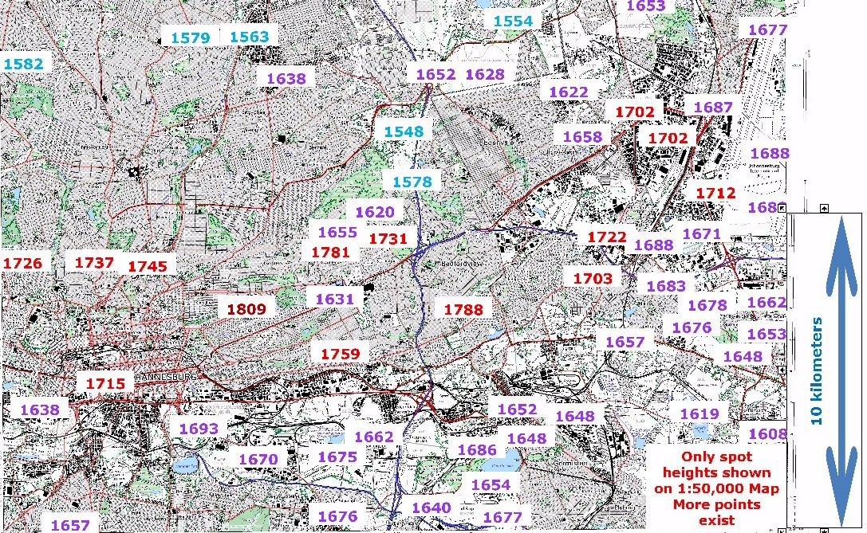
Spot heights on maps 1 in 50,000 Ordinance Survey Map 2628AA Johannesburg
Observatory Ridge -- height above sea level within 2 m of Northcliff but 10 kilometers away
Notes:
Spot heights on a couple of 1:50,000 maps to make the point – drill down and scan from one point to the next in high resolution, tie in to Google Maps if it adds value

Slide 18
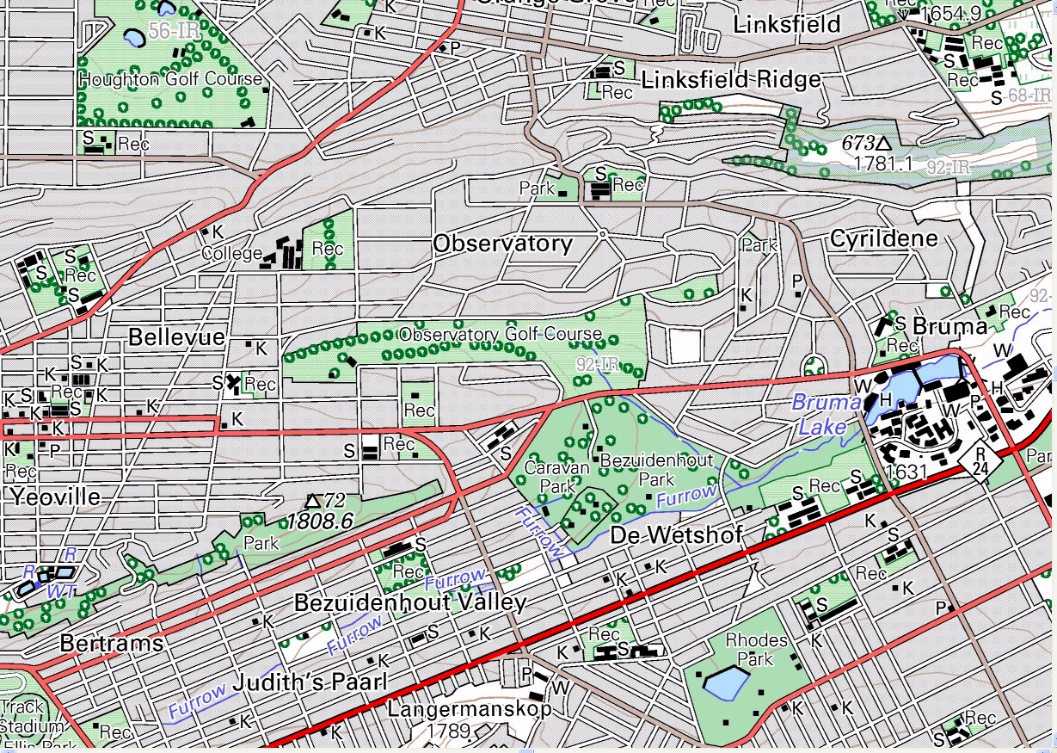
Spot heights on 1 in 50,000 maps 2628AA Johannesburg -- Observatory Ridge 1,809m ~= Northcliff
1.4% lower than Northcliff
0.01% higher than Northcliff
1.0% lower than Northcliff
Notes:
Spot heights on a couple of 1:50,000 maps to make the point – drill down and scan from one point to the next in high resolution, tie in to Google Maps if it adds value

Slide 19
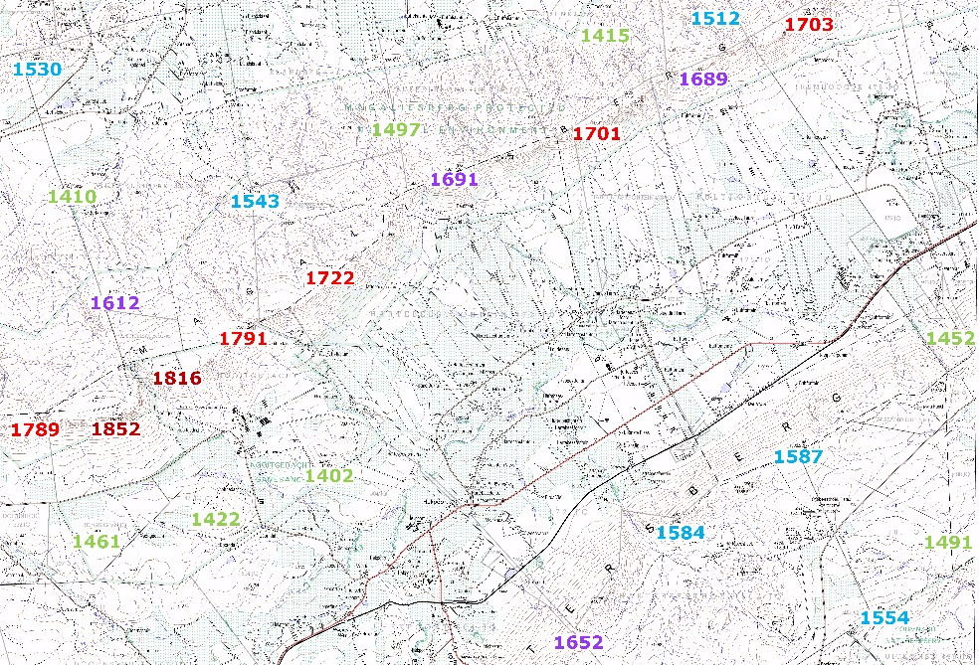
Spot heights on maps 1 in 50,000 Ordinance Survey Map 2527DC Hekpoort
Nooitgedacht Ridge -- height above sea level within 45 m of Northcliff but 50 kilometers away
Notes:
Spot heights on a couple of 1:50,000 maps to make the point – drill down and scan from one point to the next in high resolution, tie in to Google Maps if it adds value

Slide 20
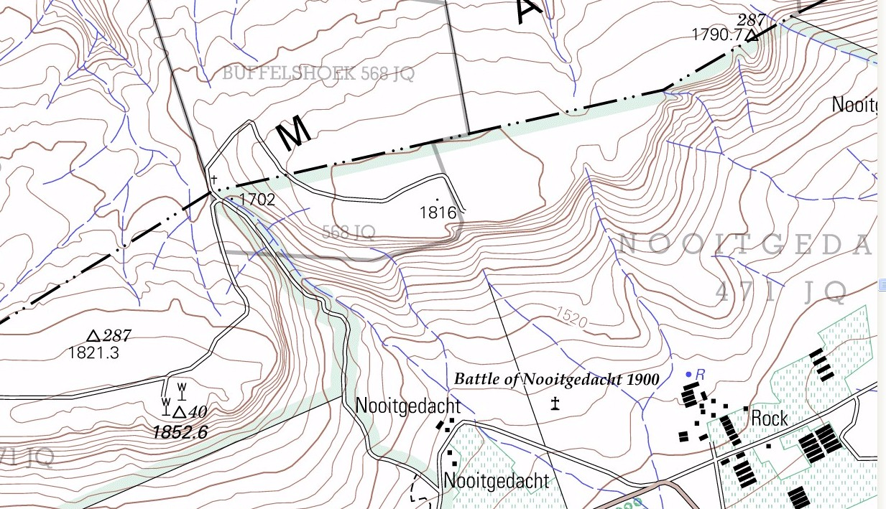
Spot heights on maps 1 in 50,000 Ordinance Survey Map 2527DC Hekpoort
1.0% lower than Northcliff
1.0% higher than Northcliff
3.0% higher than Northcliff
Notes:
Spot heights on a couple of 1:50,000 maps to make the point – drill down and scan from one point to the next in high resolution, tie in to Google Maps if it adds value

Slide 21
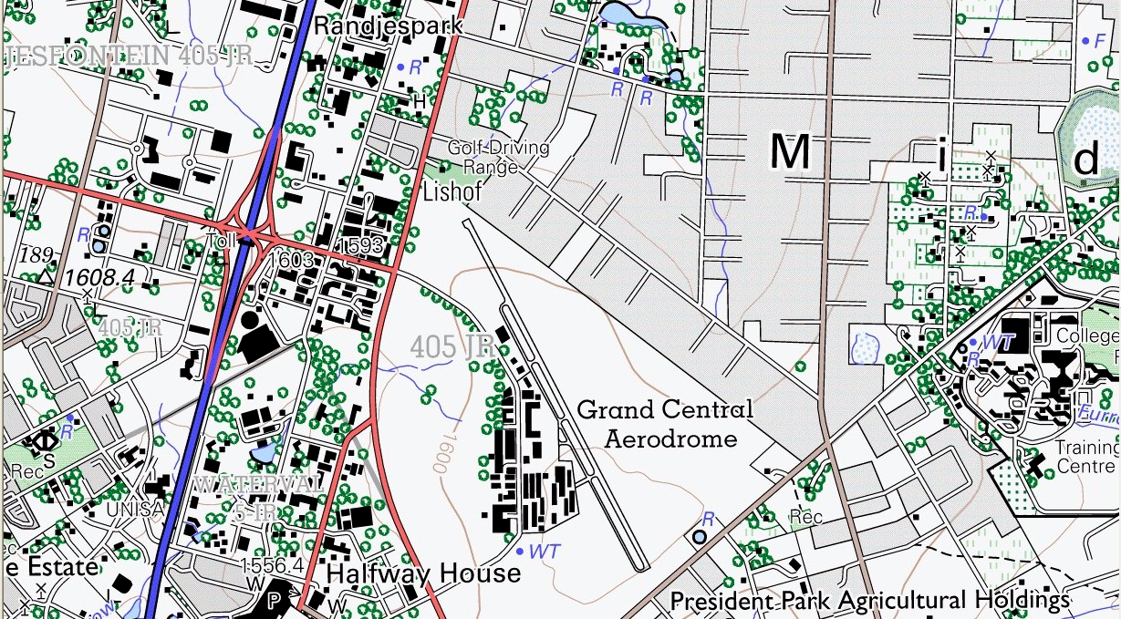
Spot heights on maps 1 in 50,000 Ordinance Survey Map 2528CC Centurion Grand Central is highest point
11.0% lower than Northcliff
1652
8.6% lower than Northcliff
Notes:
Spot heights on a couple of 1:50,000 maps to make the point – drill down and scan from one point to the next in high resolution, tie in to Google Maps if it adds value

Slide 22
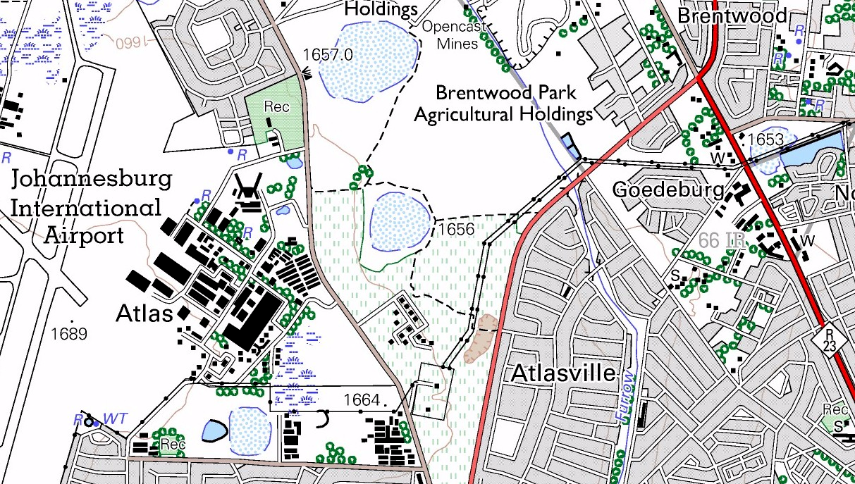
Spot heights on maps 1 in 50,000 Ordinance Survey Map 2628AB Benoni Johannesburg Airport is highest point
6.5% lower than Northcliff
Notes:
Spot heights on a couple of 1:50,000 maps to make the point – drill down and scan from one point to the next in high resolution, tie in to Google Maps if it adds value

Slide 23
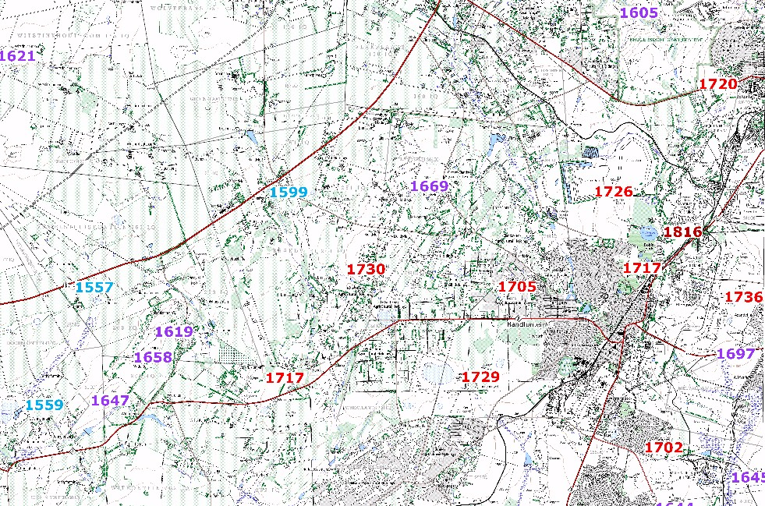
Spot heights on maps 1 in 50,000 Ordinance Survey Map 2627BA Randfontein
Notes:
Spot heights on a couple of 1:50,000 maps to make the point – drill down and scan from one point to the next in high resolution, tie in to Google Maps if it adds value

Slide 24
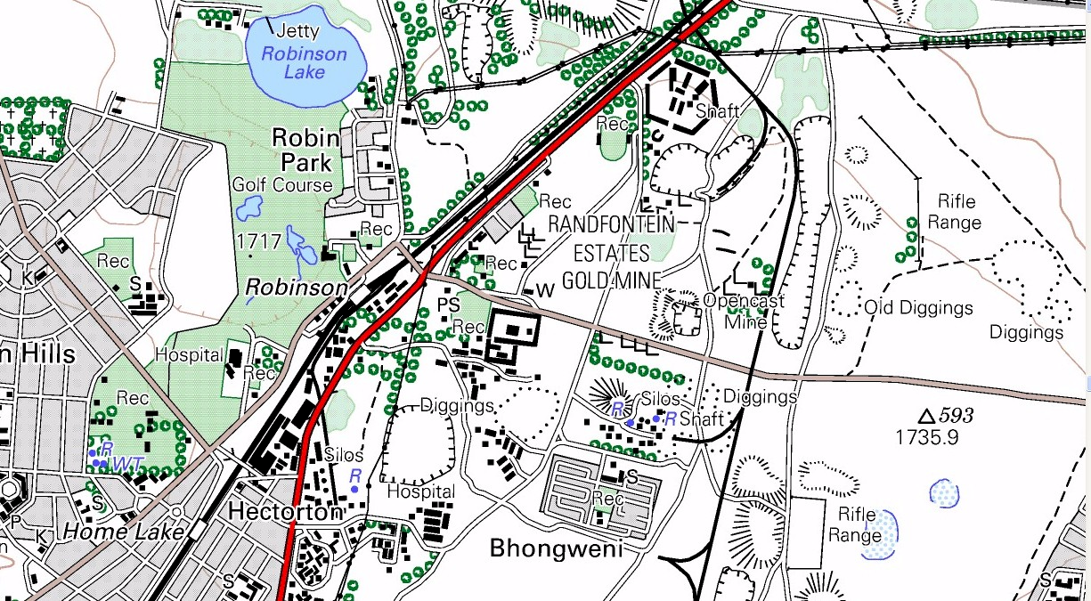
Spot heights on maps 1 in 50,000 Ordinance Survey Map 2627BA Randfontein
4.0% lower than Northcliff
Notes:
Spot heights on a couple of 1:50,000 maps to make the point – drill down and scan from one point to the next in high resolution, tie in to Google Maps if it adds value

Slide 25
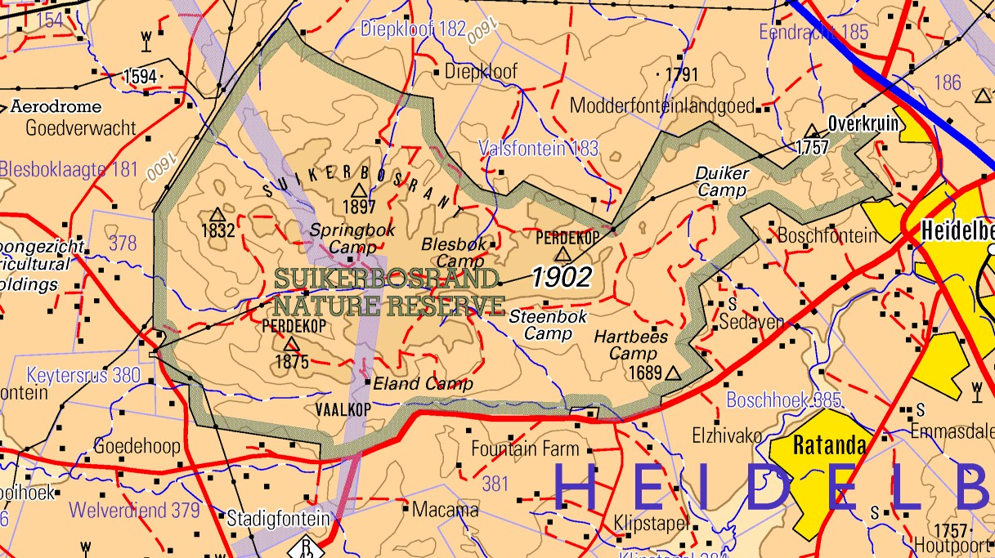
Spot heights on maps -- 1 in 250,000 Map -- 2628 East Rand – Suikerbosrand The highest point in the area
5.0% higher than Northcliff
Notes:
Spot heights on a couple of 1:50,000 maps to make the point – drill down and scan from one point to the next in high resolution, tie in to Google Maps if it adds value

Slide 26
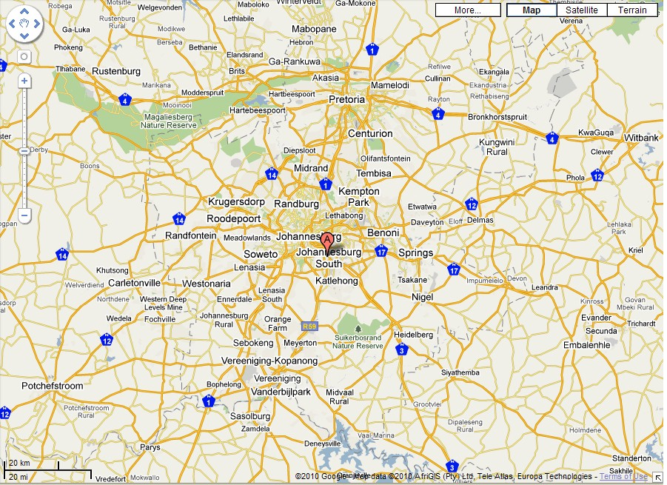
Spot heights on maps High point variation of 100 m (5%) over 100 km – a feat of engineering
1852
1652
1807
1689
1736
1809
1902

Slide 27
Spot height variation Summing up
Very small high point variation in Johannesburg area
Limited high point variation over Gauteng
Level surface visible from all high points in the area
Confirms the African Erosion Surface
A feat of engineering, VERY DIFFICULT to do in practice
Not possible to happen randomly over millions of years
Requires an overall grading mechanism to produce such a widespread level surface
Notes:
Laying concrete – slab on William Nicol
Spirit level
Road grader
View of my garden
We take flat and level for granted
Difficult to create
Cake

Slide 28
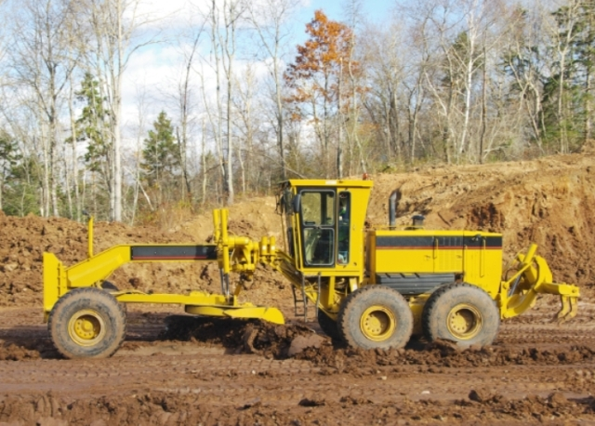
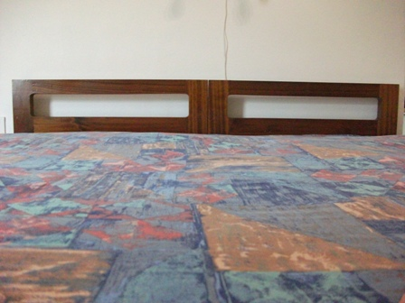
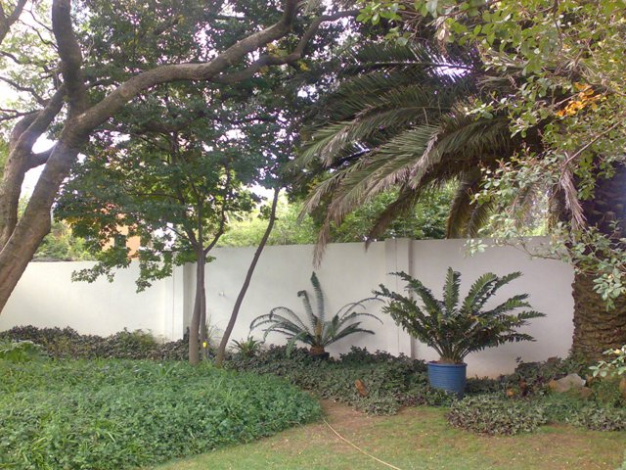
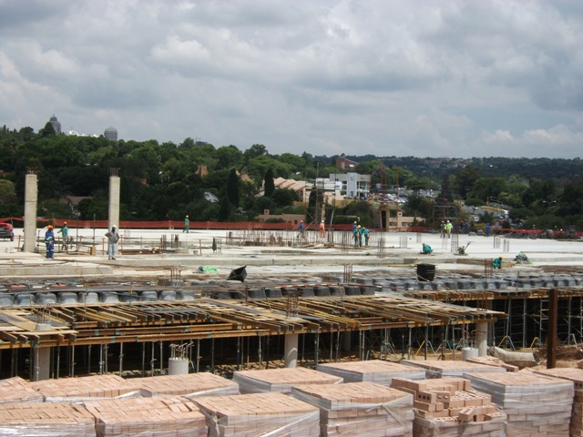
The art of plane and level
Our manmade world is precise
Level and plum all over
Buildings
Cakes (sometimes)
Furniture
Requires specialist tools and machines
Long span relative to the size of the bumps to be removed
Notes:
Laying concrete – slab on William Nicol
Spirit level
Road grader
View of my garden
We take flat and level for granted
Difficult to create
Cake

Slide 29
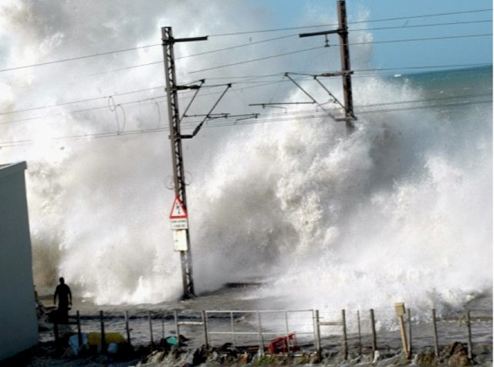
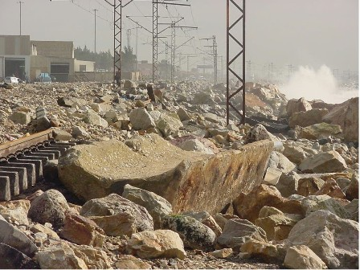
Massive wave action can move huge volumes of material very rapidly
Notes:
Different degrees of metamorphosis – Swartruggens sandstone -- pressure and no heat, Northcliff quartzite – pressure AND heat
KOV, Nchanga, Phalaborwa, etc

Slide 30
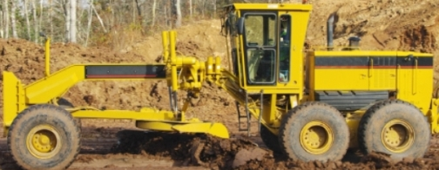
So how did the African Erosion Surface get to be so level? Tsunami?
Notes:
What force could plane these rocks off so level over such a wide area?
Something that applies a uniform shearing / cutting force over a wide area on a consistent enough basis to achieve this high level of uniformity with such massive removal of material?
A global tidal wave ripping round the planet repeatedly as the earth rotated, cutting down layer after layer?
What about a Tsunami?

Slide 31
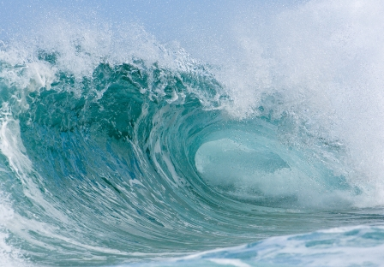
A global tidal wave?
Large span tidal waves
With uniform velocity and depth over considerable distances
Are capable of cutting down the surface of the earth to remove vast amounts of material uniformly
As required to cut the top off the Halfway House Granite Dome and the sedimentary layers upthrust by the dome
Entirely consistent with a planet covered in water with the tides running as massive continuous Tsunamis around the planet
Massive cutting down in very short time spans
Notes:
What force could plane these rocks off so level over such a wide area?
Something that applies a uniform shearing / cutting force over a wide area on a consistent enough basis to achieve this high level of uniformity with such massive removal of material?
A global tidal wave ripping round the planet repeatedly as the earth rotated, cutting down layer after layer?
What about a Tsunami?

Slide 32
What other explanation fits?
Please reflect on your own practical life experience and knowledge
What else can explain the topgraphic forms (land forms) we see around us?
Do not abdicate your intellect
Check this theory out for yourself as you drive around, look at travel books, etc
Notes:
Reflect on your own experience of flat and level? and uniform?
What other explanations can you come up with?

Slide 33
Summing up
Massive flat plane (level with the sea level but cannot see the sea)
Nearly 2,000 meters above sea level
Seems impossible?
Cannot possibly have occurred slowly over millions of years – too uniform
What caused it?
There is no reasonable explanation apart from massive (global) wave / water action
How could such a thing occur?
Where has the water gone (and where did it come from?)

Slide 34
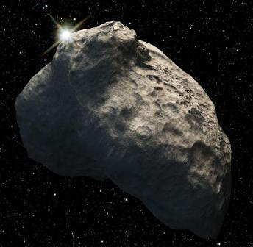
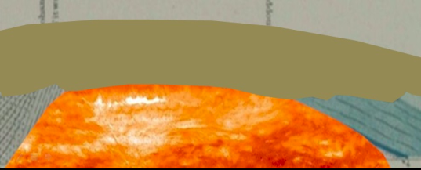
Conclusions thus far
An unstable universe with runaway stars, massive planetary impacts, massive ice blocks in space, etc
Sedimentary deposits over thousands of kilometers and to depths in excess of ten thousand meters in places
Can only have been eroded and deposited by massive hydraulic action consistent with a global flood
Massive igneous (molten rock) intrusions consistent with a thin crust and massive crustal disruption due to an external force
Massive erosion of upthrust material to give a level plane over thousands of kilometers can only be explained by massive hydraulic action consistent with a global sea and massive tidal waves

Slide 35
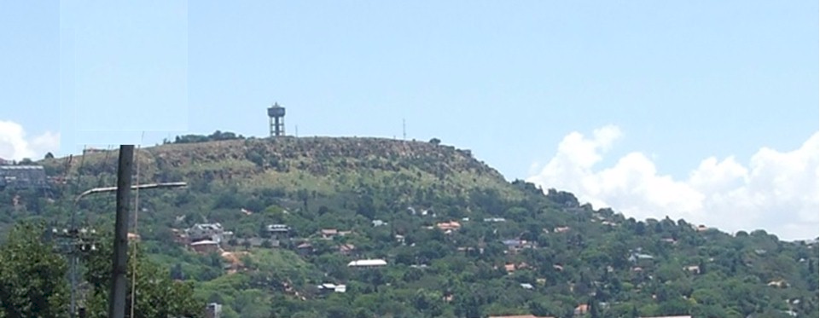
Turning history on its head
Massive evidence of a global flood
What does it all mean?
Continued in part 6
Incised Valley’s
Contact me James@ETI-Ministries.org Website www.ETI-Ministries.org

