Slide 1
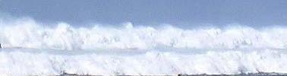
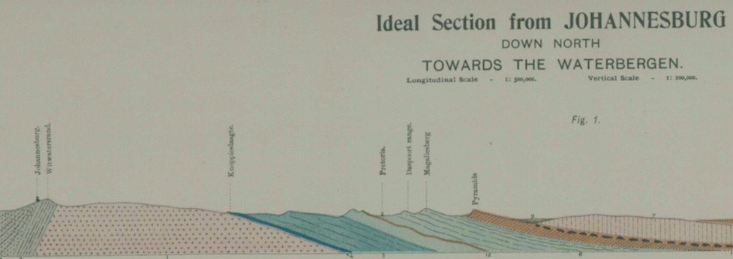
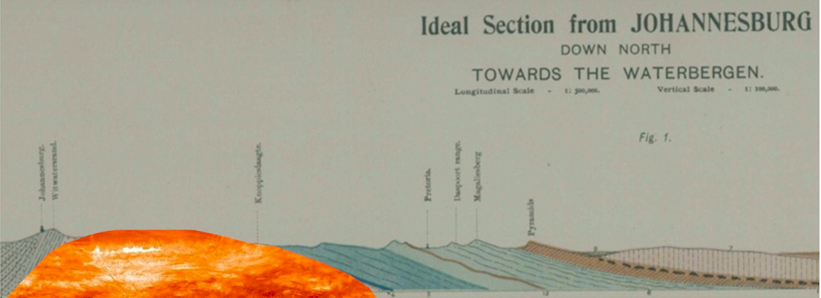

Turning history on its head
Massive evidence of a global flood
What does it all mean?
Part 4 – The Halfway House
Granite Dome and other massive igneous intrusions -- the furnace
End Time Issue Ministries
Dr James A Robertson PrEng
Notes:
Find a photo of a large granite dome
Where did the material go that was around it – shapes
OR Northcliff or Primrose and Magaliesberg and draw in the dome and the layers above the dome

Slide 2
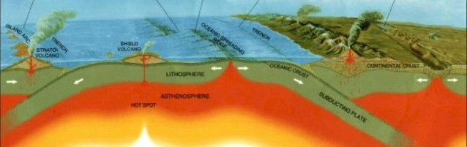
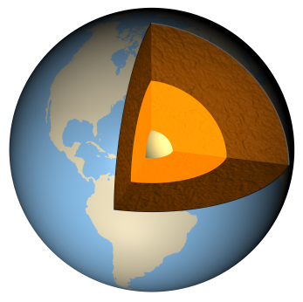
The earth has a molten rock core
Notes:
Small domes in lowveld
Images from paper on deep drill hole in Germany other domes from iStock

Slide 3
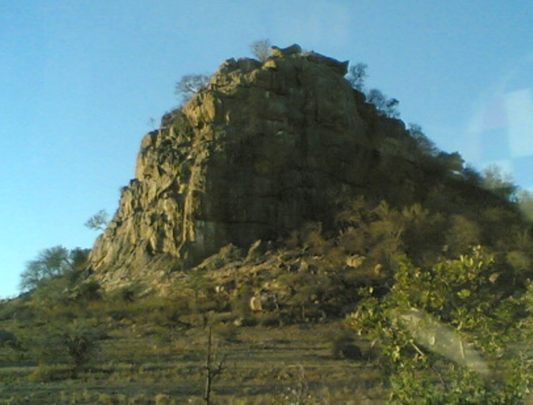
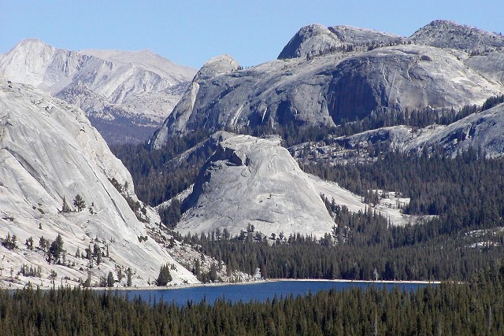
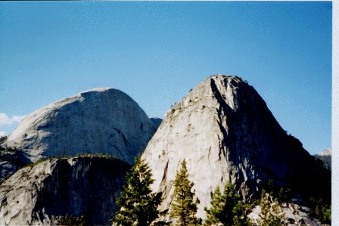
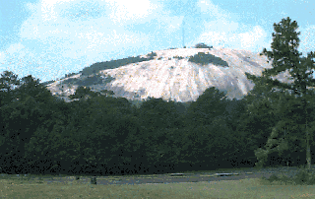
What is a dome?
A massive granite intrusion
Pywiack Dome, USA
Kruger Park
South Africa
Granite Domes in Yosemite National Park USA
Stone Mountain, Georgia, USA
Notes:
Small domes in lowveld
Images from paper on deep drill hole in Germany other domes from iStock

Slide 4
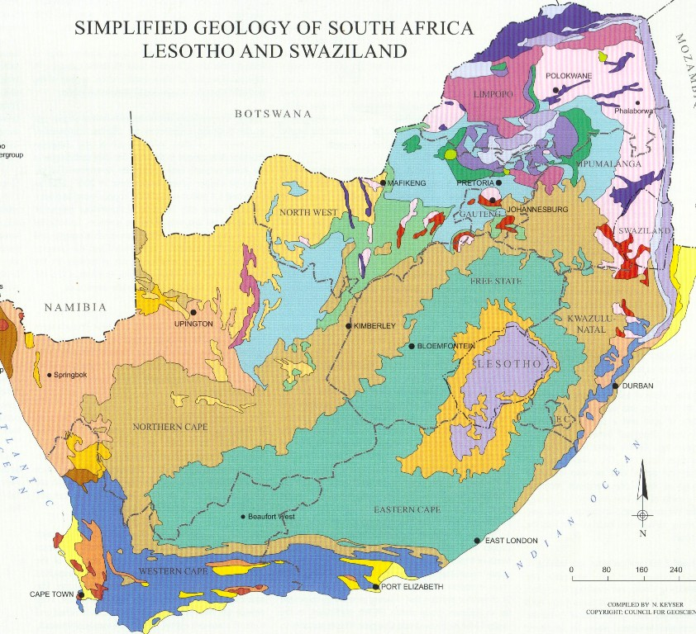
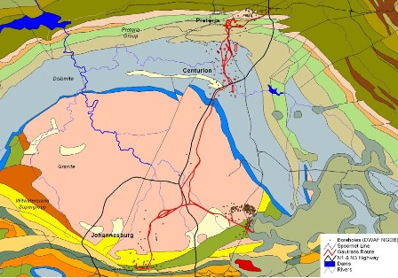
What is a dome?
A massive granite intrusion
Halfway House Granite Dome
Notes:
Small domes in lowveld
Images from paper on deep drill hole in Germany other domes from iStock

Slide 5
What is a dome?
Upthrust of molten rock through a weak zone in the earth’s crust
Forces up horizontally bedded rocks in an arch over the intrusion
Bakes them as in a furnace and converts to semi-vitreous (ceramic) quartzite, etc – extremely hard rock
Notes:
Small domes in lowveld
Images from paper on deep drill hole in Germany other domes from iStock

Slide 6
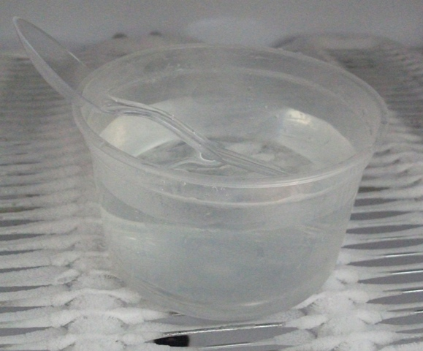
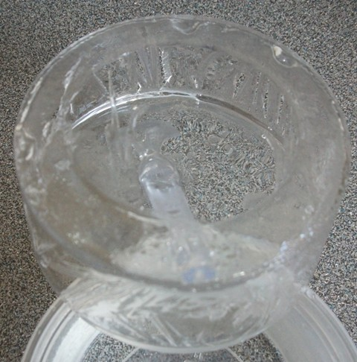
A thin crust
Implies a thin crust at the time
Cooling and solidifying from the outside inwards
Notes:
How is this possible?
The crust is reportedly 40 to 60 km thick?
What if earth core is cooling rapidly?
Thin crust
Ice photo’ becomes solid from outside in
What if as it cools it contracts and puts pressure on the core and the core has to force its way out?

Slide 7
Rapid cooling of molten granite
Dr Robert Gentry presents research that evidences that the Granite rocks on the surface of the earth cooled rapidly
Consistent with the above explanation
Refer subsequent sections – this supports an understanding that the molten rock may have come into contact with massive volumes of freezing cold water and therefore solidified almost instantly
Notes:
How is this possible?
The crust is reportedly 40 to 60 km thick?
What if earth core is cooling rapidly?
Thin crust
Ice photo’ becomes solid from outside in
What if as it cools it contracts and puts pressure on the core and the core has to force its way out?

Slide 8
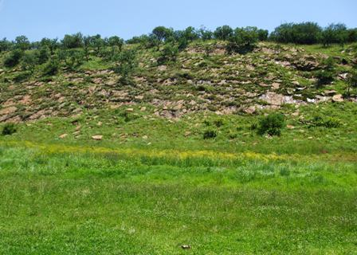
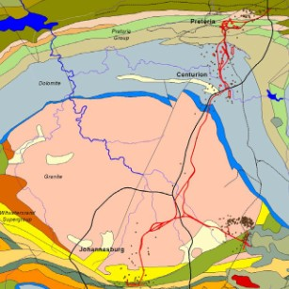
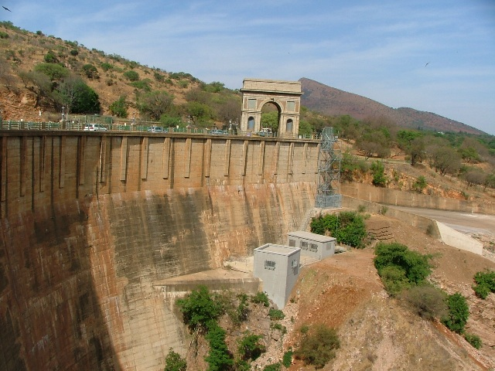
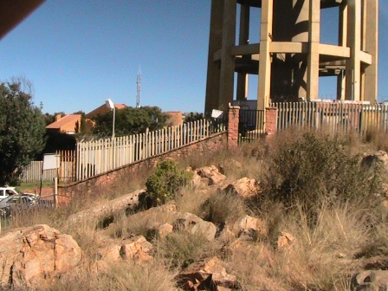
30 degree slopes
Kloofendal dipping
30 deg West
Magaliesberg dipping
30 deg North
Northcliff dipping
30 deg South
Notes:
Magaliesberg, Northcliff – from a better angle? Roodepoort?
Back slopes
Cuttings
Other photos

Slide 9
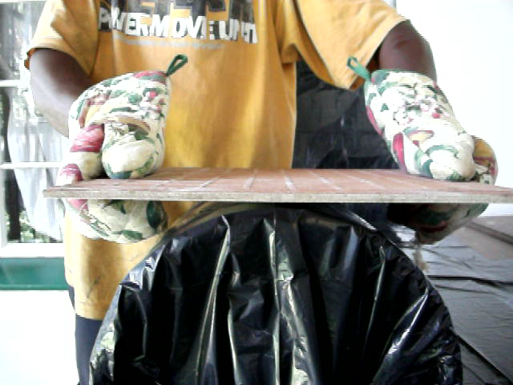
The rock was NOT rock at the time hard rock would shatter if bent for example – ceramic tile
Notes:
Photo’s and videos breaking ice, not breaking ice, breaking tile, show how tile is hard ceramic like rock on Northcliff – close up of both
Kerfed would and not kerfed wood
The rock is NOT cracked open and kerfed as would be the case if it was hard when the dome thrust up, it is conformed to the dome like the window putty and then baked to vitreous rock

Slide 10
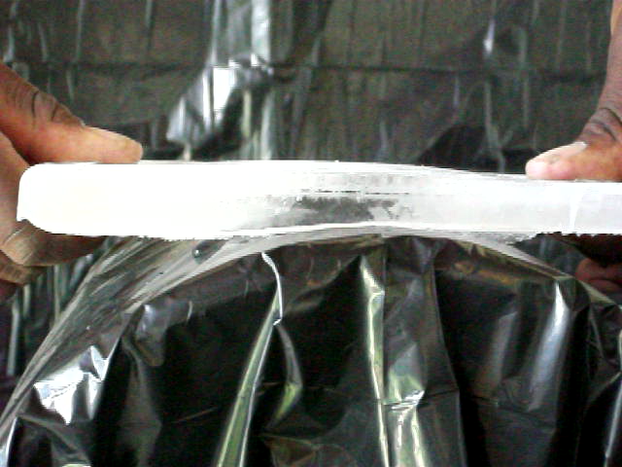
The rock was NOT rock at the time hard rock would shatter if bent for example – thin slab of ice
Notes:
Photo’s and videos breaking ice, not breaking ice, breaking tile, show how tile is hard ceramic like rock on Northcliff – close up of both
Kerfed would and not kerfed wood
The rock is NOT cracked open and kerfed as would be the case if it was hard when the dome thrust up, it is conformed to the dome like the window putty and then baked to vitreous rock

Slide 11
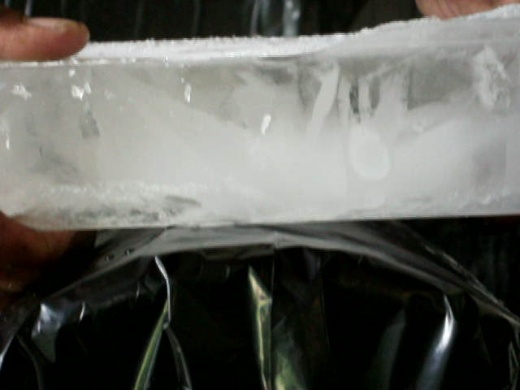
The rock was NOT rock at the time hard rock would shatter if bent or NOT break at all – thicker ice
Notes:
Photo’s and videos breaking ice, not breaking ice, breaking tile, show how tile is hard ceramic like rock on Northcliff – close up of both
Kerfed would and not kerfed wood
The rock is NOT cracked open and kerfed as would be the case if it was hard when the dome thrust up, it is conformed to the dome like the window putty and then baked to vitreous rock

Slide 12
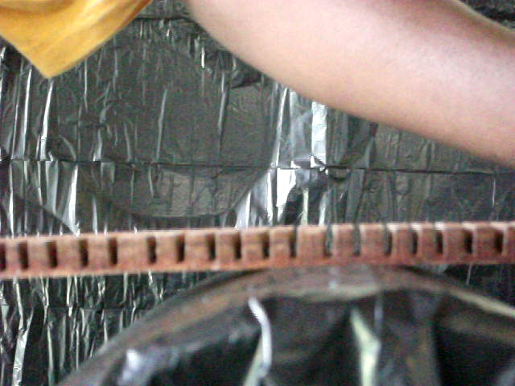
The rock was NOT rock at the time if the rock was cracked it would bend but the cracks would open up
Notes:
Photo’s and videos breaking ice, not breaking ice, breaking tile, show how tile is hard ceramic like rock on Northcliff – close up of both
Kerfed would and not kerfed wood
The rock is NOT cracked open and kerfed as would be the case if it was hard when the dome thrust up, it is conformed to the dome like the window putty and then baked to vitreous rock

Slide 13
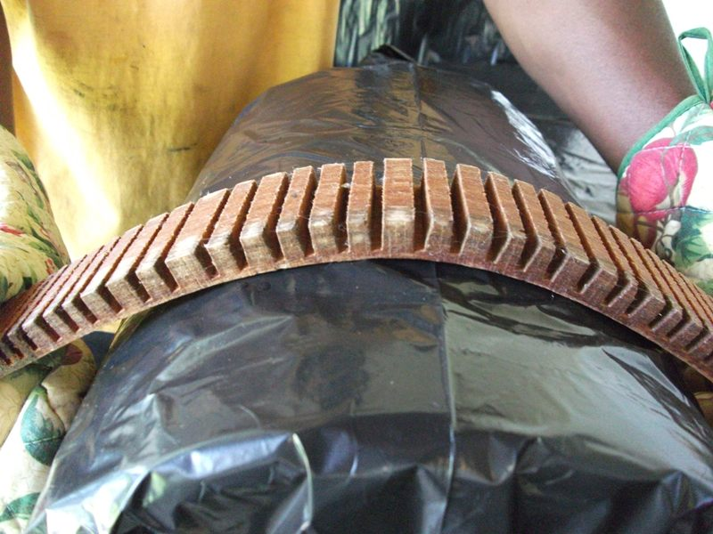
The rock was NOT rock at the time if the rock was cracked it would bend but the cracks would open up
Notes:
Photo’s and videos breaking ice, not breaking ice, breaking tile, show how tile is hard ceramic like rock on Northcliff – close up of both
Kerfed would and not kerfed wood
The rock is NOT cracked open and kerfed as would be the case if it was hard when the dome thrust up, it is conformed to the dome like the window putty and then baked to vitreous rock

Slide 14
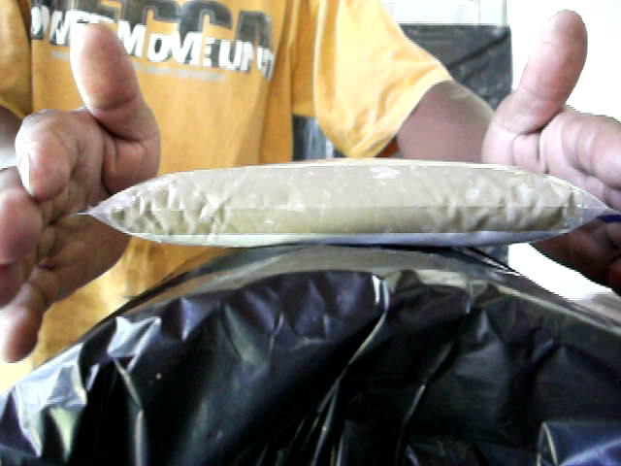
The rock was NOT rock at the time soft, newly deposited sand and mud would CONFORM to the intrusion
Notes:
Photo’s and videos breaking ice, not breaking ice, breaking tile, show how tile is hard ceramic like rock on Northcliff – close up of both
Kerfed would and not kerfed wood
The rock is NOT cracked open and kerfed as would be the case if it was hard when the dome thrust up, it is conformed to the dome like the window putty and then baked to vitreous rock

Slide 15
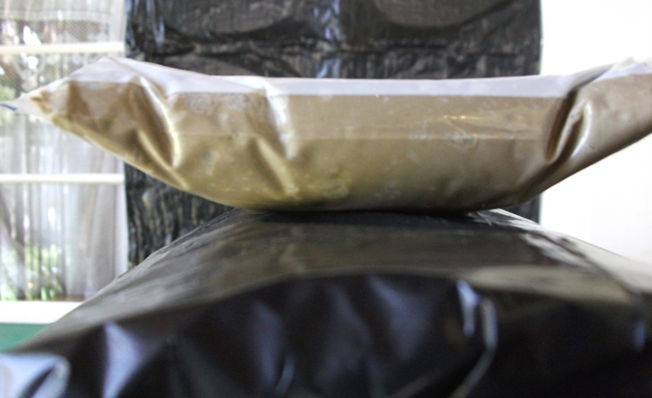
The rock was NOT rock at the time soft, newly deposited sand and mud would CONFORM to the intrusion
Notes:
Photo’s and videos breaking ice, not breaking ice, breaking tile, show how tile is hard ceramic like rock on Northcliff – close up of both
Kerfed would and not kerfed wood
The rock is NOT cracked open and kerfed as would be the case if it was hard when the dome thrust up, it is conformed to the dome like the window putty and then baked to vitreous rock

Slide 16
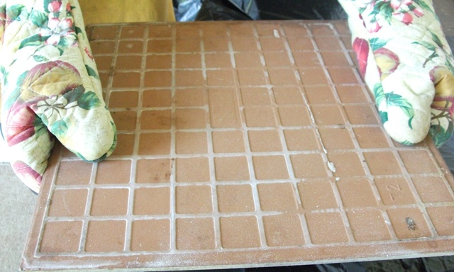
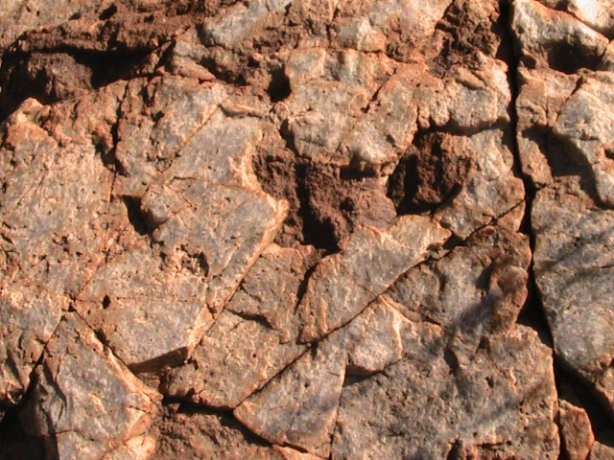
Quartzite – evidence of intense heat
Notes:
Photo’s and videos breaking ice, not breaking ice, breaking tile, show how tile is hard ceramic like rock on Northcliff – close up of both
Kerfed would and not kerfed wood
The rock is NOT cracked open and kerfed as would be the case if it was hard when the dome thrust up, it is conformed to the dome like the window putty and then baked to vitreous rock

Slide 17
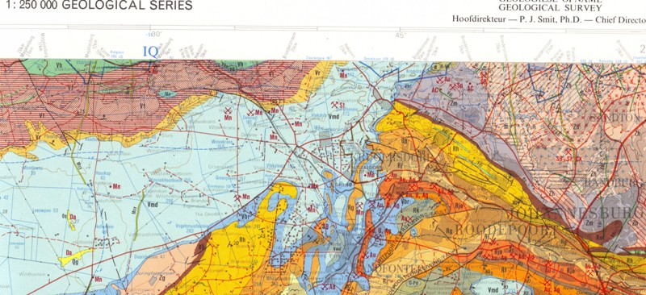
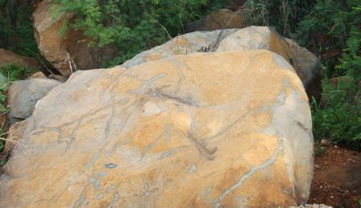
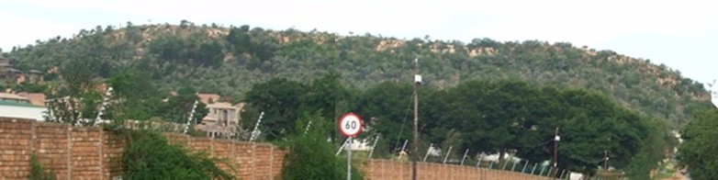
Subsequent further igneous activity
Dykes and faults
Dolerite intrusion through Granite
Much other disruption
Randpark Ridge Mylonite Dyke (intrusion through Granite)
Notes:
But the dome and surroundings are ALSO intersected with igneous intrusions
Randpark Ridge
Dolerite dykes, eg Northwold
The Johannesburg Graben,
Potato masher video clip
etc

Slide 18
Summing up
Huge -- how?
The scale is huge about 50 km diameter at the surface
The vertical displacement of the top of the dome is at LEAST 7,000 meters (26 Hillbrow Towers)
The sedimentary deposits were converted to extremely hard vitreous (ceramic) quartzite
This had to happen quickly before the granite solidified that is “froze”
The disruption of the surface of the earth is staggering
How could something like this happen?
Will it happen again?
Notes:
The scale is huge
How did it happen?
What level of disruption is required to allow a dome to push up what might be as much as 7 kilometers ?? Check this calculation vertically – contrast with well known building heights again
What forces triggered this?
What forces kept it going

Slide 19
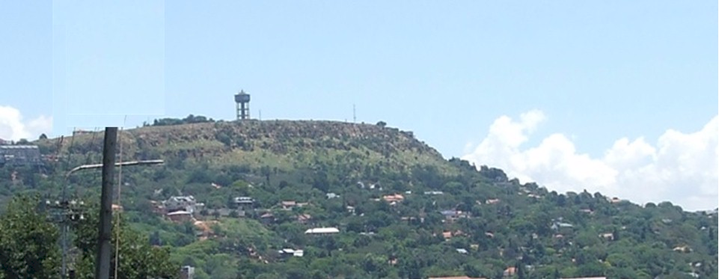
Turning history on its head
Massive evidence of a global flood
What does it all mean?
Continued in part 5
The African Erosion Surface
Contact me James@ETI-Ministries.org Website www.ETI-Ministries.org

