Slide 1
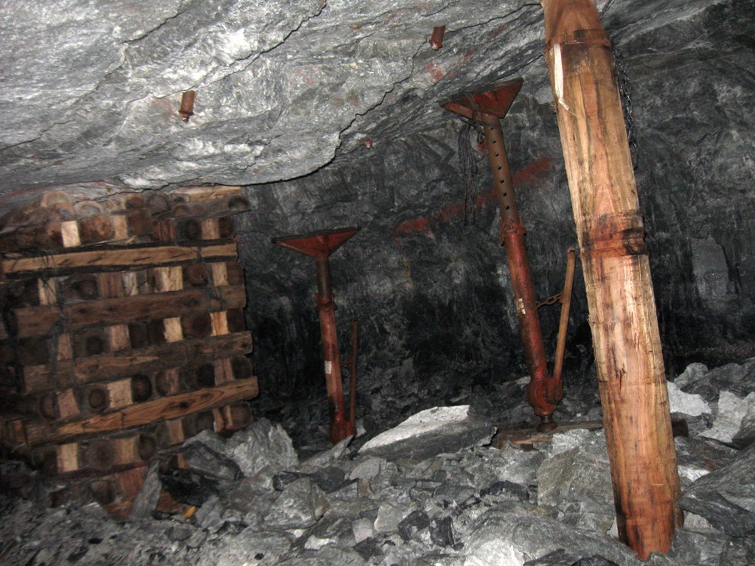
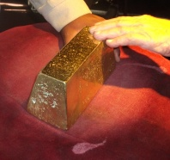

Turning history on its head
Massive evidence of a global flood
What does it all mean?
Part 2 -- Gold Mines in South Africa
Courtesy of Mark Grave
End Time Issue Ministries
Dr James A Robertson PrEng
Notes:
Add headgear, gold pour, gold bar
Change line on midline of stope face to yellow and tie in to gold pour, etc

Slide 2
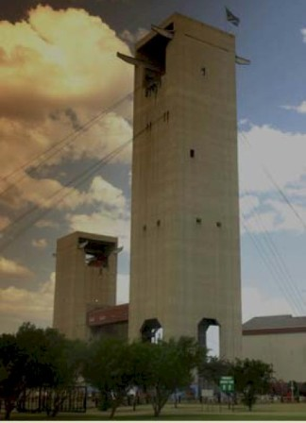
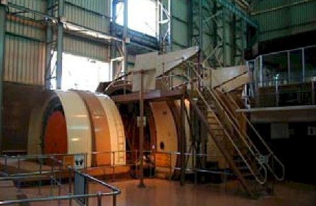
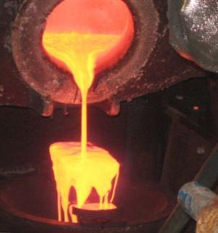
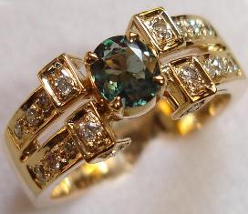
Gold mining, a precision industry
Notes:
Gold jewellery
Headgears
Locating the ore
Mining at huge depths with safety
Massive cooling
Precision explosions
Chemically extracting the gold from the rock
Minute quantities, grams per ton – gold ring against tonnes of ore
Gold plant – ball mill, etc
Goldpour
Slimes dams

Slide 3
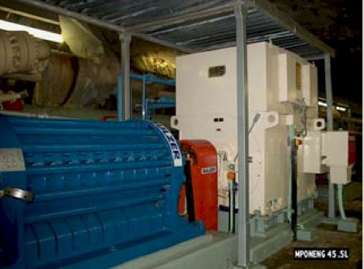
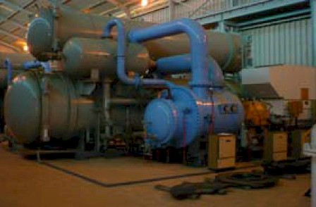
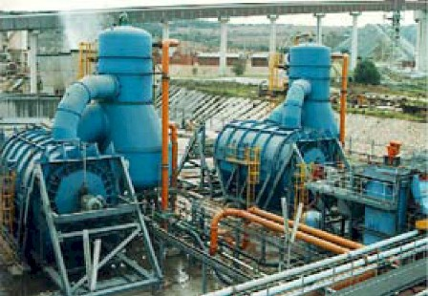
Gold mining, massive machinery, energy, force
Notes:
Gold jewellery
Headgears
Locating the ore
Mining at huge depths with safety
Massive cooling
Precision explosions
Chemically extracting the gold from the rock
Minute quantities, grams per ton – gold ring against tonnes of ore
Gold plant – ball mill, etc
Goldpour
Slimes dams

Slide 4
Gold mining, a precision industry
The Gold is in thin veins which must be carefully located and traced and blasted out of extremely hard rock
Locating the Gold is a major activity with exploration drilling from the surface
The Gold bearing rock (ore) must be kept separate from the waste rock, dilution is a major cost driver
The ore is crushed very finely and the gold is extracted chemically with a very precise process
The gold is then extracted from the chemical mix and smelted in a furnace from which rough gold bars are produced
Fine gold is extracted and then sold for manufacturing of jewellery, electronic circuitry, etc
South Africa has produced 40% of recent world Gold production from these mines
Notes:
Gold jewellery
Headgears
Locating the ore
Mining at huge depths with safety
Massive cooling
Precision explosions
Chemically extracting the gold from the rock
Minute quantities, grams per ton – gold ring against tonnes of ore
Gold plant – ball mill, etc
Goldpour
Slimes dams

Slide 5
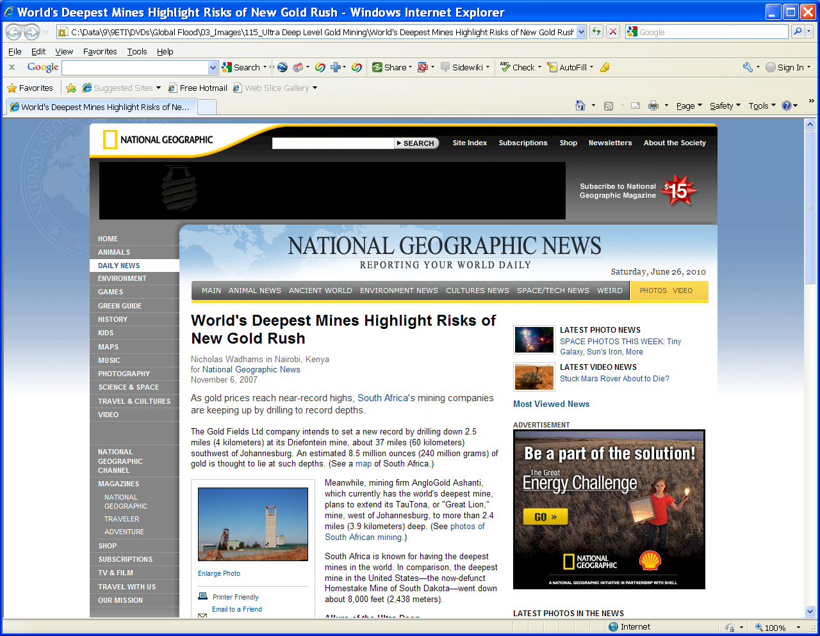



Deepest Gold Mine over 3.9 kilometers deep
14.5 x Hillbrow Tower
4.7 x Burj Khalifa
2 kilometers BELOW sea level
Notes:
Gold jewellery
Headgears
Locating the ore
Mining at huge depths with safety
Massive cooling
Precision explosions
Chemically extracting the gold from the rock
Minute quantities, grams per ton – gold ring against tonnes of ore
Gold plant – ball mill, etc
Goldpour
Slimes dams

Slide 6
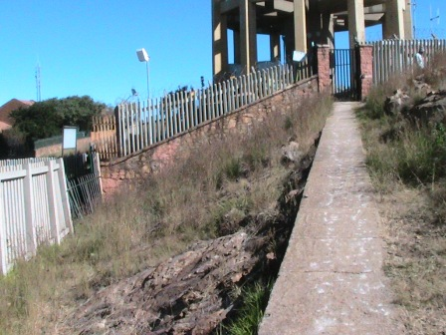
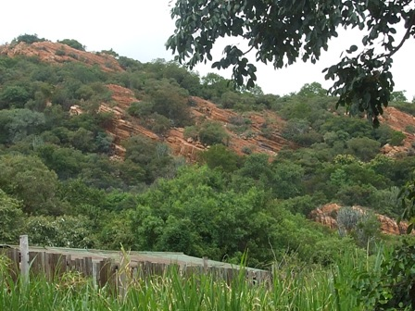
The same geological formation as Northcliff and the Magaliesberg
Northcliff
Magaliesberg
+/- 50 km
North
Gold Mine
+/- 0.5 to 4 km
Underground
~ 5 km to 100 km South
Notes:
Same formation as Northcliff and the Magaliesberg – photos of both
Great extent, map of gold fields
Collage of headgears

Slide 7
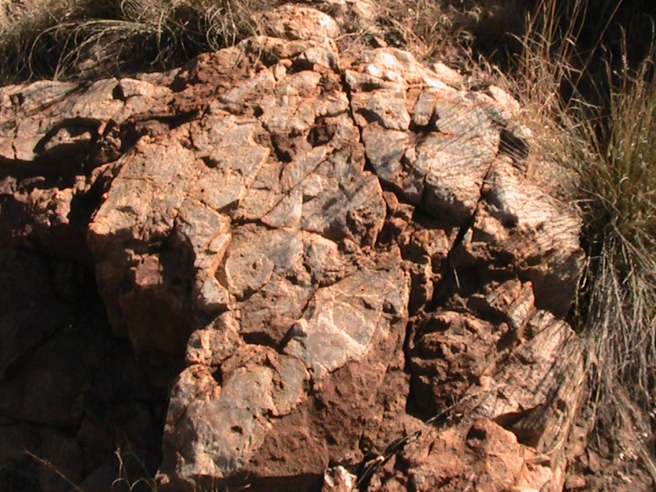
Hard metamorphosed rock
Northcliff – vitrified (ceramic) Quartzite – intense heat and pressure
Gold mine– vitrified (ceramic) Quartzite – intense heat and pressure
Notes:
Very hard rock – same as Northcliff – suggestion of comparable pressure on formation
Metamorphosed
Pressure and heat
Roller compacted concrete dam
Photos from my thesis – samples – creation of artificial rock

Slide 8
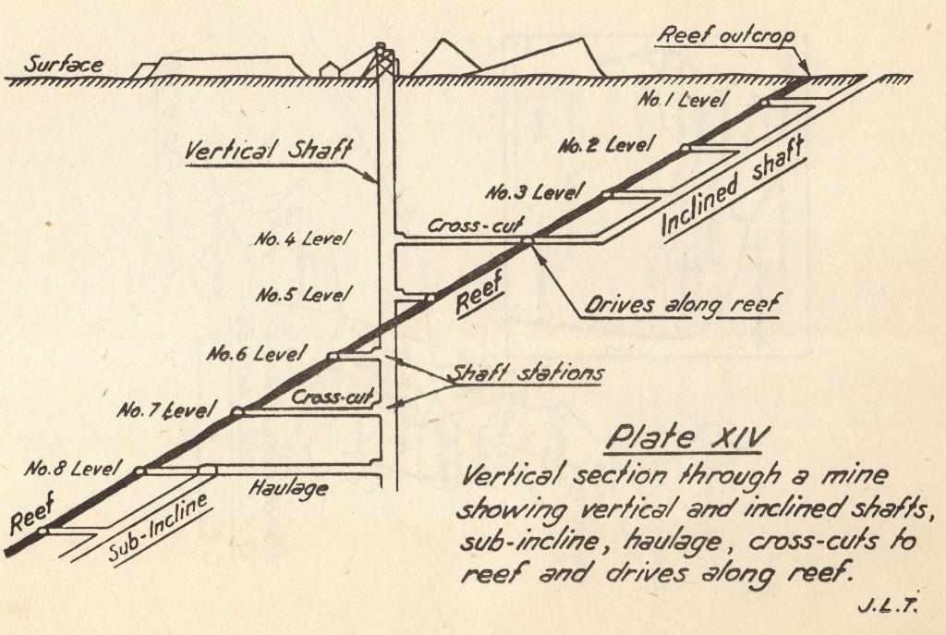
Dipping at about 30 degrees
Horizontally deposited under water but now dipping about thirty degrees
How did this
Happen?
Notes:
Horizontally deposited under water but now dipping at about 30 degrees to the South and the West with Northcliff as a pivot point relative to the mines in the East and South and those on the West
Vertical section through a shaft showing dip, tunnels, drives, etc

Slide 9
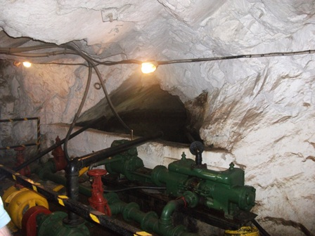
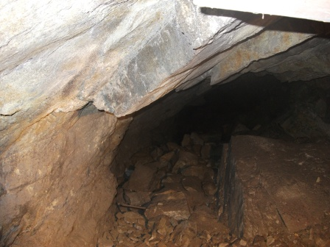
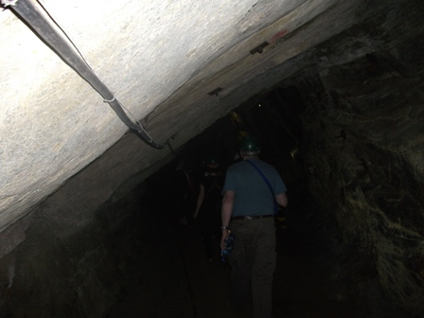
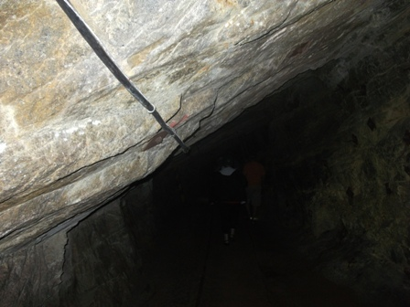
Dipping at about 30 degrees
Notes:
Horizontally deposited under water but now dipping at about 30 degrees to the South and the West with Northcliff as a pivot point relative to the mines in the East and South and those on the West
Vertical section through a shaft showing dip, tunnels, drives, etc

Slide 10
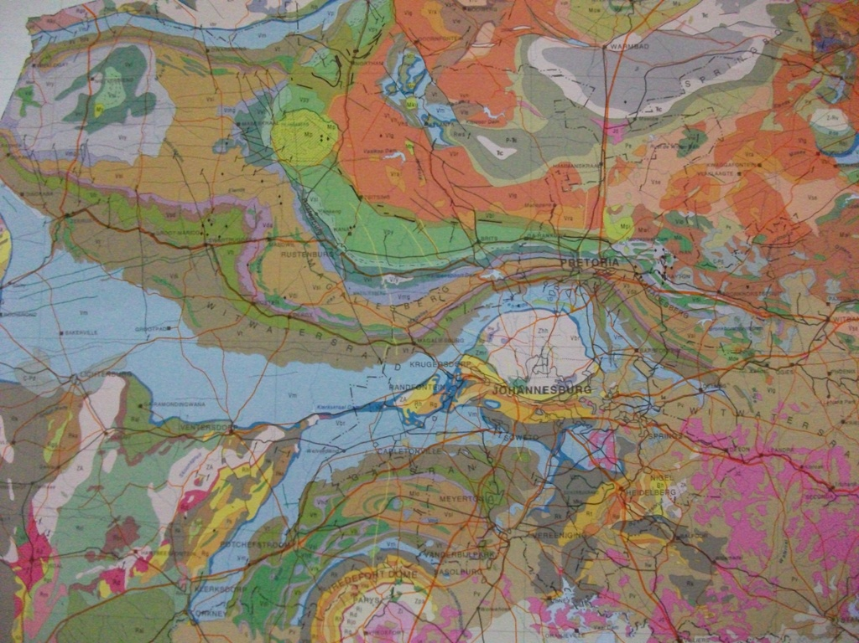
Highly complex geology
Notes:
Same formation as Northcliff and the Magaliesberg – photos of both
Great extent, map of gold fields
Collage of headgears

Slide 11
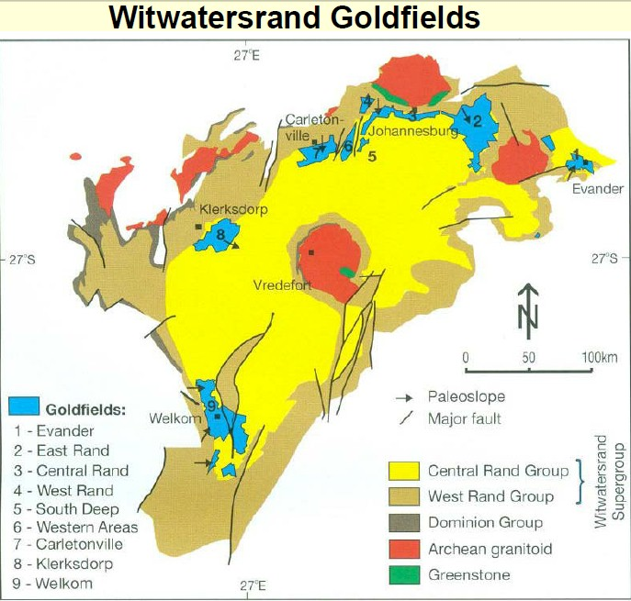
Gold fields
Dispersed and highly faulted
Notes:
Same formation as Northcliff and the Magaliesberg – photos of both
Great extent, map of gold fields
Collage of headgears

Slide 12
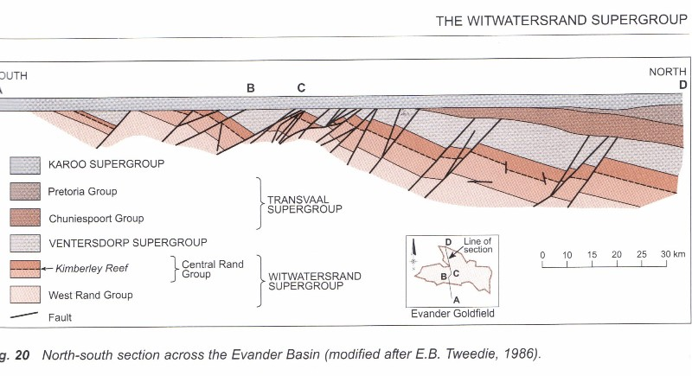
Highly faulted
Top cut off level
Horizontal deposits on top
Notes:
Faulting to great depth
Deepest shafts to / planned to over 5 km under ground, 3 km below sea level
Show tallest building in Johannesburg and tallest in the world stacked against depth of 5 km
Massive faulting, blocks moved
Dip varies,
Depth varies
Sections from Geology of South Africa and other sources
Johannesburg Graben – dolerite dyke

Slide 13
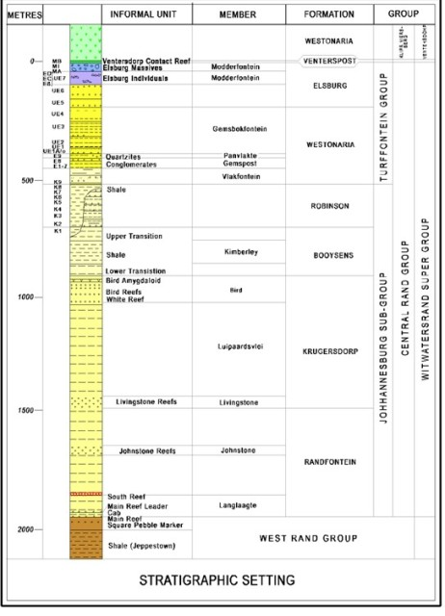

Great depth and extent
Stratigraphic column
Stratigraphic column over 2,000m vertical depth = 7.4 x Hillbrow Tower
i.e. The body of water in which this material was deposited was able to receive the discharge of two (2) kilometers vertical depth of sediment
And there had to be a source of material for two kilometers of deposition
And the deepest mines are close to four (4) kilometers deep, that is over two (2) kilometers BELOW current SEA LEVEL
Notes:
Rough scale drawing – deduce thickness perpendicular to slope from distances on 1:50,000 or find a direct reference to the thickness of the Witwatersrand system – Mark Grave
Stratigraphic column about 2,000 m deep – reaches to below sea level and then the deepest ore body is about 6 km underground, 4 km below sea level and the deepest mine is close to 4 km deep, about 2,000 m below sea level
Diagram

Slide 14
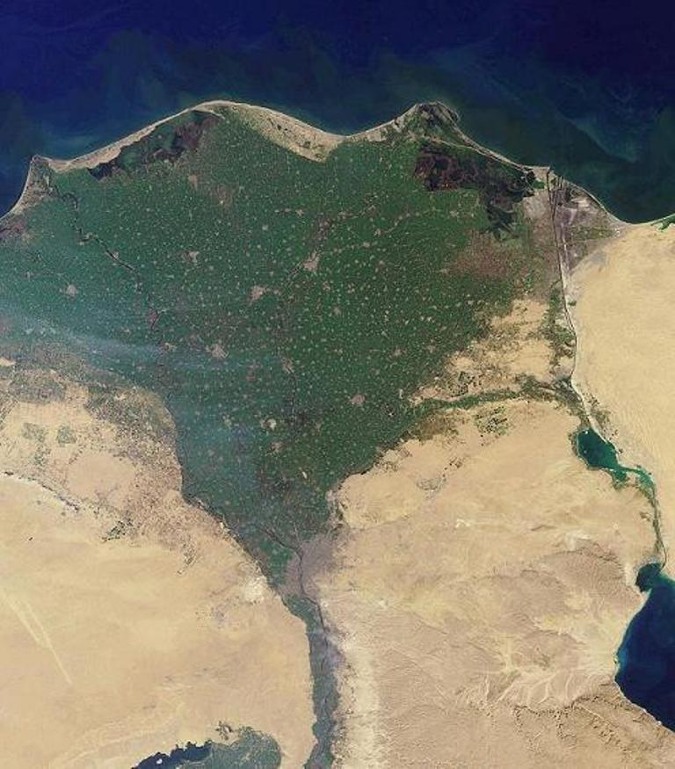
Massive hydraulic action
Required a very large body of water in terms of depth, extent and erosion sources
NOT a stream deposited formation or delta – the ore bodies are of reasonably uniform thickness and wide extent
A VERY VERY VERY LARGE SEA
Widespread uniform deposition implies
  widespread uniform sea
  high velocity deposition
Nile Delta
Notes:
Massive hydraulic action
Very large body of water
No evidence of delta’s (show Nile or Red Sea – from Google Earth) – diagram of advancing slope
No evidence of edge of the inland sea
More sedimentary rocks hundreds and even thousands of miles away
Massive tectonic action accompanying the massive hydraulic action
Any explanation must deal precisely with what the miners have found
Look for references to signs of human artefacts in South African mines

Slide 15



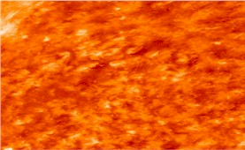
Massive depth and extent of water
Massive surface vertical displacement
Top of Northcliff 1807 m above sea level
> 2 km
Sea level
Proven Gold Deposits
> 5 km
Halfway House Granite Dome
Molten Rock
> 2 km
Reef
2 km = 7.4 x Hillbrow Tower
5 km = 18.6 x Hillbrow Tower

Slide 16
Summing up
Huge depth and extent
Horizontally deposited but now sloping steeply
Massive faulting
Can only result from deposition in water over a large area
Subject to intense pressure and temperature
Where did it come from?
How did it happen?

Slide 17
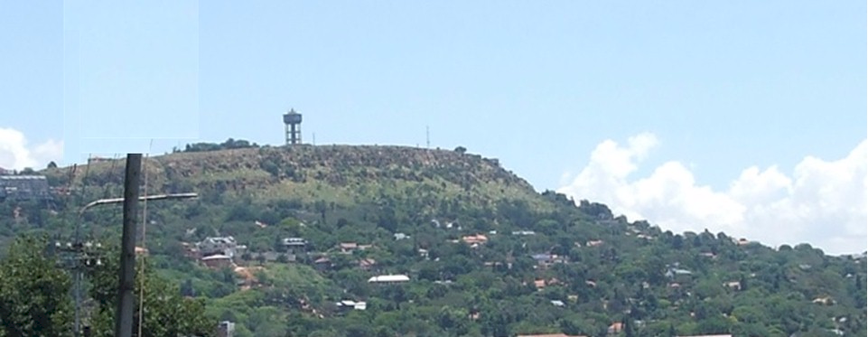
Turning history on its head
Massive evidence of a global flood
What does it all mean?
Continued in part 3
Global occurrence of layered sedimentary rocks
Contact me James@ETI-Ministries.org Website www.ETI-Ministries.org

