Slide 1
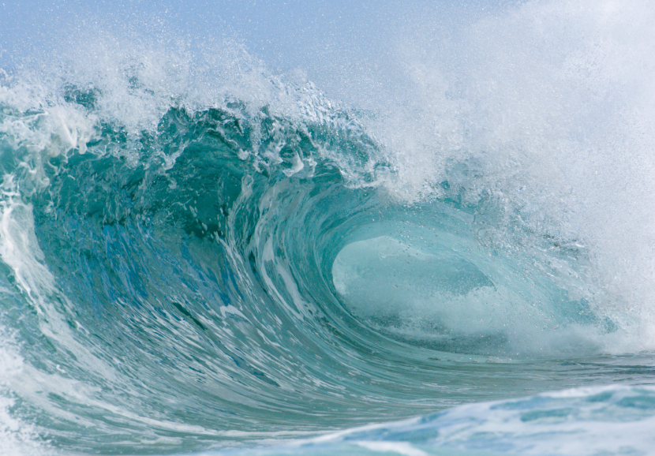
Japan – 11 March 2011
Notes:
What force could plane these rocks off so level over such a wide area?
Something that applies a uniform shearing / cutting force over a wide area on a consistent enough basis to achieve this high level of uniformity with such massive removal of material?
A global tidal wave ripping round the planet repeatedly as the earth rotated, cutting down layer after layer?
What about a Tsunami?

Slide 2
Japan, 11 March 2011
On 11 March 2011, as we were finalizing the production of these videos, a massive earthquake (Richter 8.9) and tsunamis hit Japan
These images give some indication of the horror of the experience and the massive damage done by some quite small waves
This DVD presents a wide range of evidence that indicates that at some stage in the history of the earth waves hundreds of times greater than these rampaged the earth together with massive earth movements and totally re-formed the surface of the earth
We consider evidence that every land form that you are familiar with is a consequence of massive earth movement and massive water forces
And we consider the possibility that this did not happen so long ago and that it warns of a possible future judgment
Notes:
Advanced buildings and technology
Fire, pit, throne? Or blinding light – something that gives hope and something that portrays negative judgment
Possibly the graph from pit to mountain

Slide 3
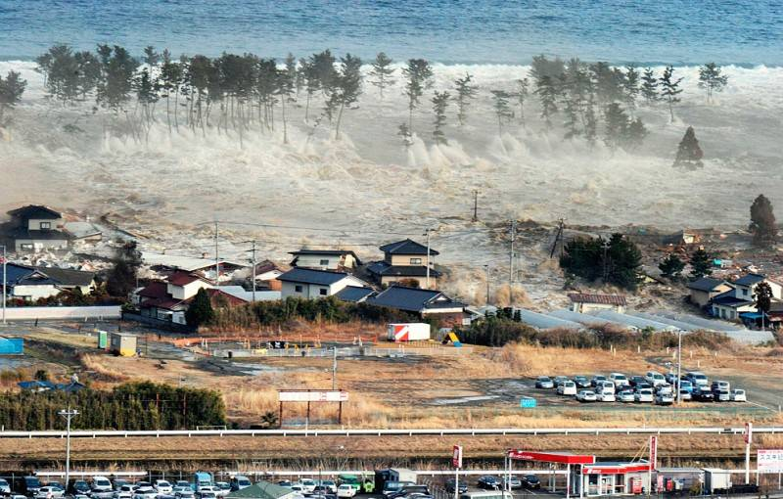
Notes:
Advanced buildings and technology
Fire, pit, throne? Or blinding light – something that gives hope and something that portrays negative judgment
Possibly the graph from pit to mountain

Slide 4
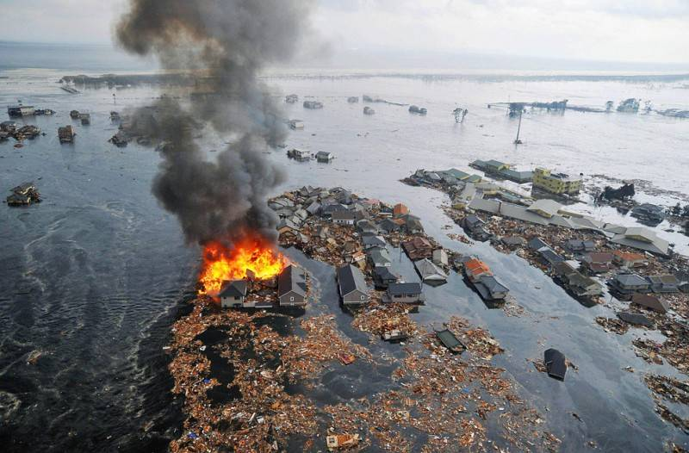
Notes:
Advanced buildings and technology
Fire, pit, throne? Or blinding light – something that gives hope and something that portrays negative judgment
Possibly the graph from pit to mountain

Slide 5
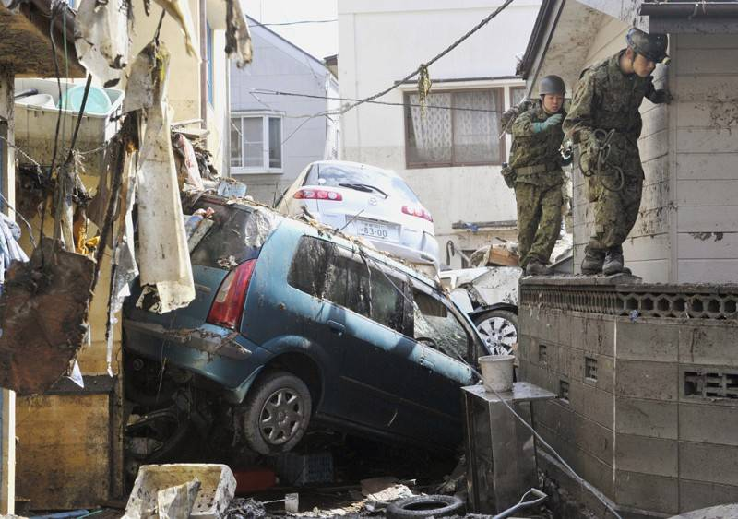
Notes:
Advanced buildings and technology
Fire, pit, throne? Or blinding light – something that gives hope and something that portrays negative judgment
Possibly the graph from pit to mountain

Slide 6
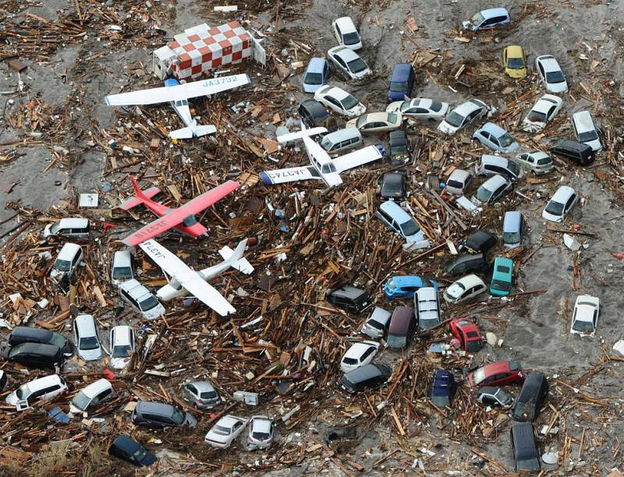
Notes:
Advanced buildings and technology
Fire, pit, throne? Or blinding light – something that gives hope and something that portrays negative judgment
Possibly the graph from pit to mountain

Slide 7
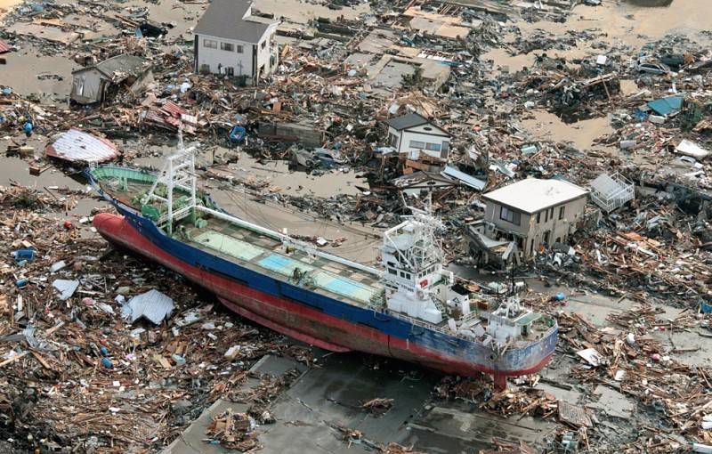
Notes:
Advanced buildings and technology
Fire, pit, throne? Or blinding light – something that gives hope and something that portrays negative judgment
Possibly the graph from pit to mountain

Slide 8
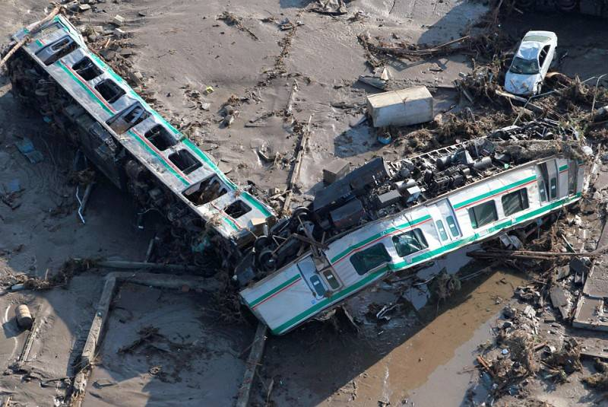
Notes:
Advanced buildings and technology
Fire, pit, throne? Or blinding light – something that gives hope and something that portrays negative judgment
Possibly the graph from pit to mountain

Slide 9
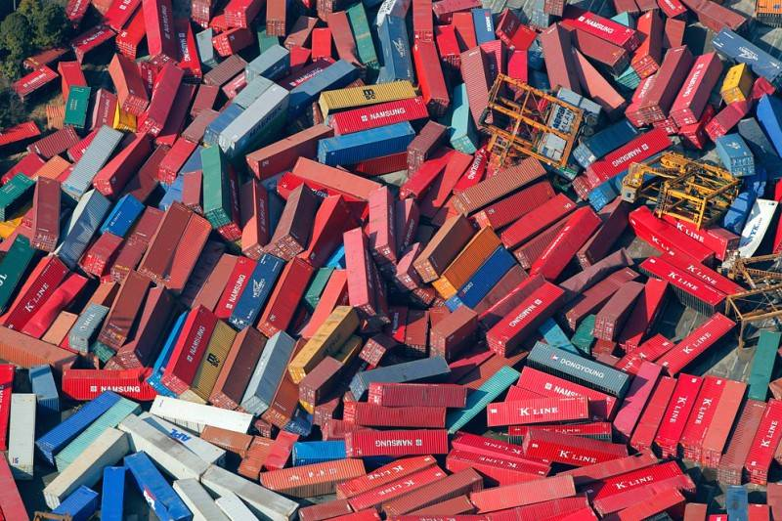
Notes:
Advanced buildings and technology
Fire, pit, throne? Or blinding light – something that gives hope and something that portrays negative judgment
Possibly the graph from pit to mountain

Slide 10
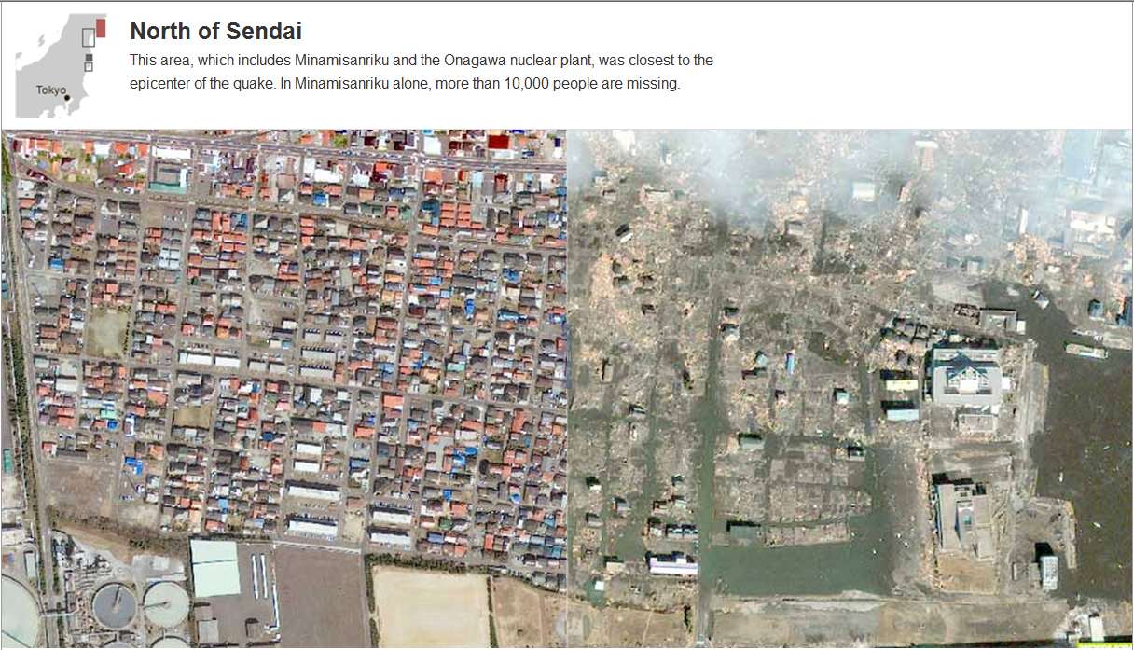
Before
After
Notes:
Advanced buildings and technology
Fire, pit, throne? Or blinding light – something that gives hope and something that portrays negative judgment
Possibly the graph from pit to mountain

Slide 11
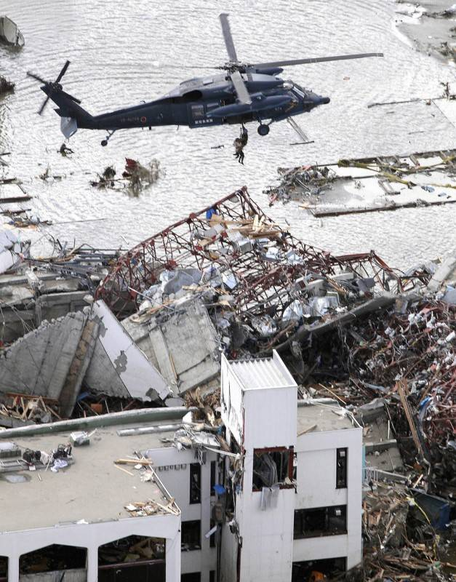
Notes:
Advanced buildings and technology
Fire, pit, throne? Or blinding light – something that gives hope and something that portrays negative judgment
Possibly the graph from pit to mountain

Slide 12
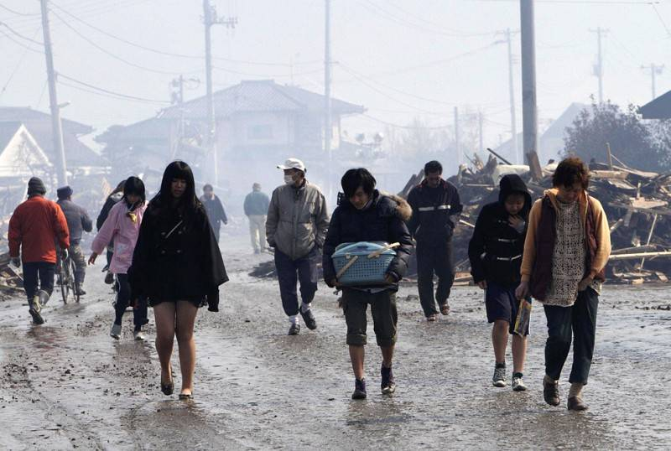
Notes:
Advanced buildings and technology
Fire, pit, throne? Or blinding light – something that gives hope and something that portrays negative judgment
Possibly the graph from pit to mountain

Slide 13
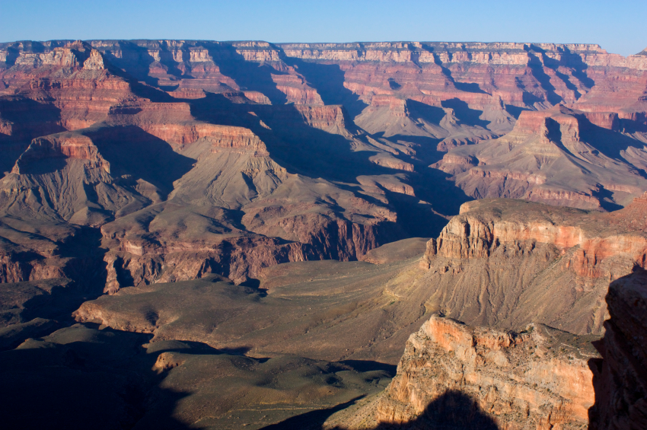
Introduction
Overview of some important engineering and logical principles for analysis of information
Credentials of Dr James Robertson PrEng
Some key observations from outer space that point to long term instability and ready availability of large volumes of water
Northcliff as the pivot point of a wide diversity of geological and topographic information that points to a global flood
Important to view this before viewing the rest of the series
Notes:
Advanced buildings and technology
Fire, pit, throne? Or blinding light – something that gives hope and something that portrays negative judgment
Possibly the graph from pit to mountain

Slide 14
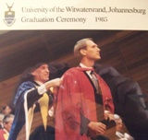
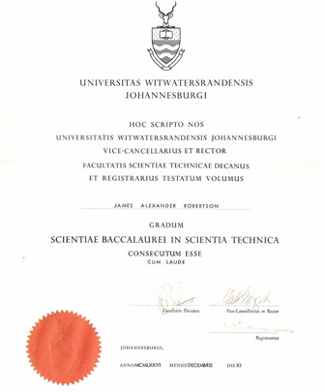
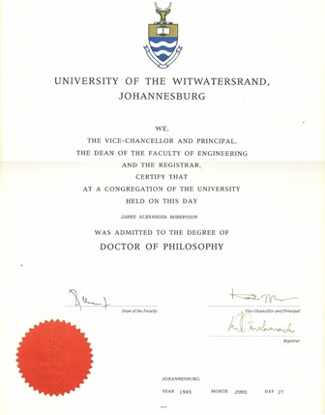
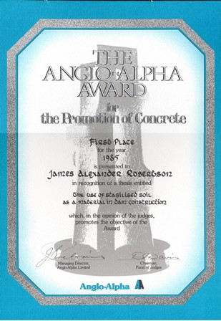
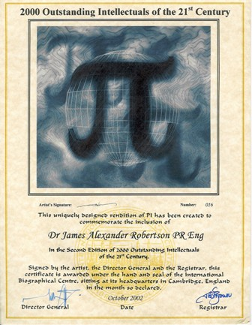
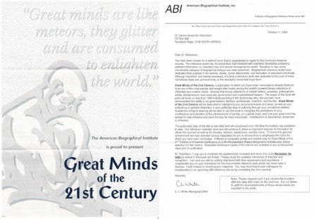
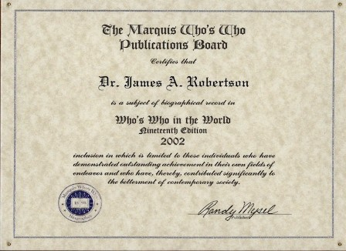
Credentials Academic and Engineering
End High School 1971 Grade 12 -- distinctions in Maths, Science and Biology
Top Biology student in South Africa National Youth Science Week -- 1971
BSc Engineering (Civil) Cum Laude -- 1976
Doctor of Philosophy Civil Engineering -- 1985
Anglo Alpha award for the Promotion
of Concrete for PhD
2000 Outstanding Intellectuals
Great Minds of the 21st Century
Who’s Who in the World five times
Other accolades
Notes:
JAR nice photo in corner of each credentials slide
Graduation photo in middle of slide with degree certificates and memberships, etc
Matric, BSc, high grades throughout, Science, focus on understanding
Engineering, analysis, IT, economics, engineering principles – images of degrees, Anglo Alpha, PhD graduation, SAICE, SAIMM – all on one page as a collage fade in progressively

Slide 15
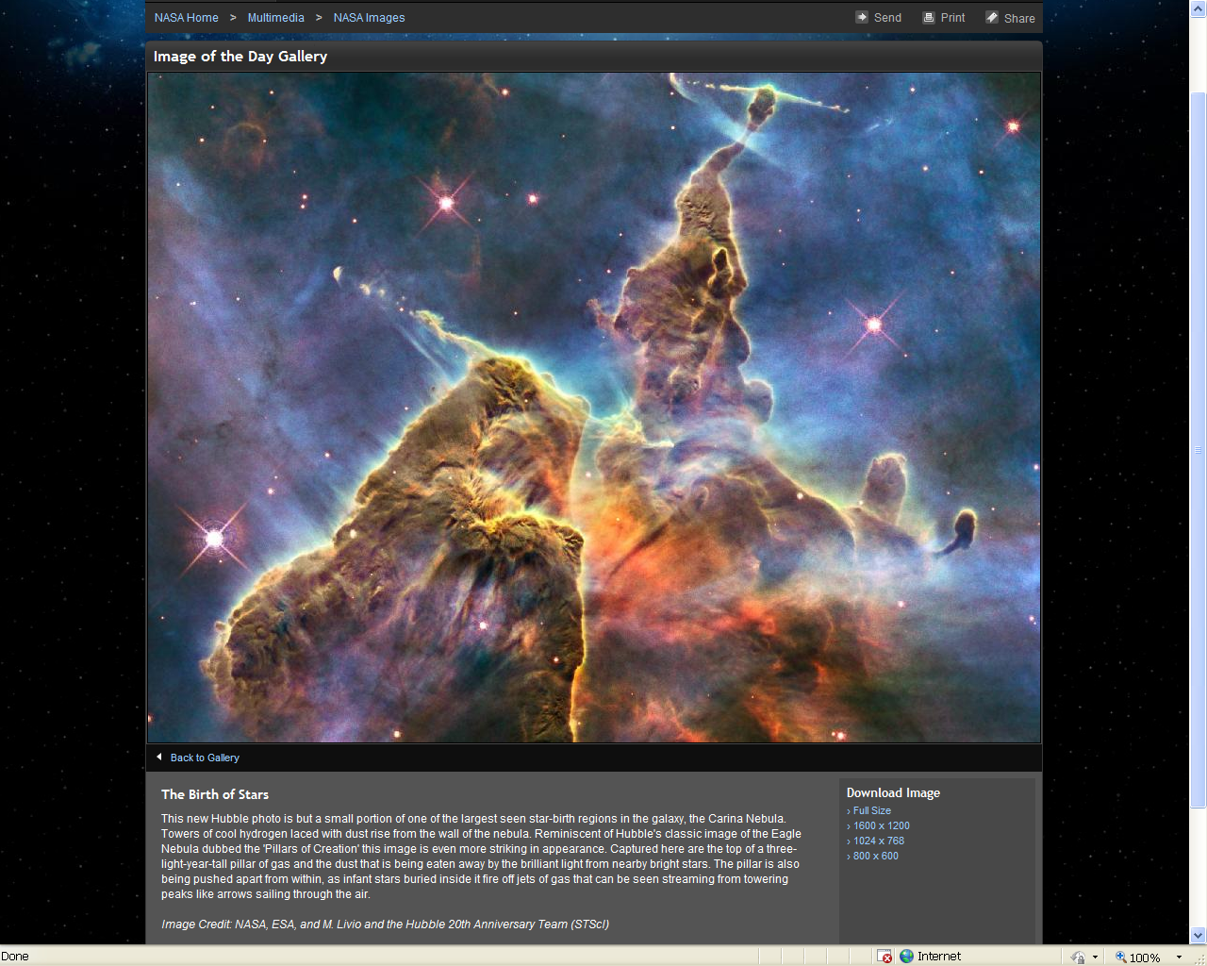

Slide 16
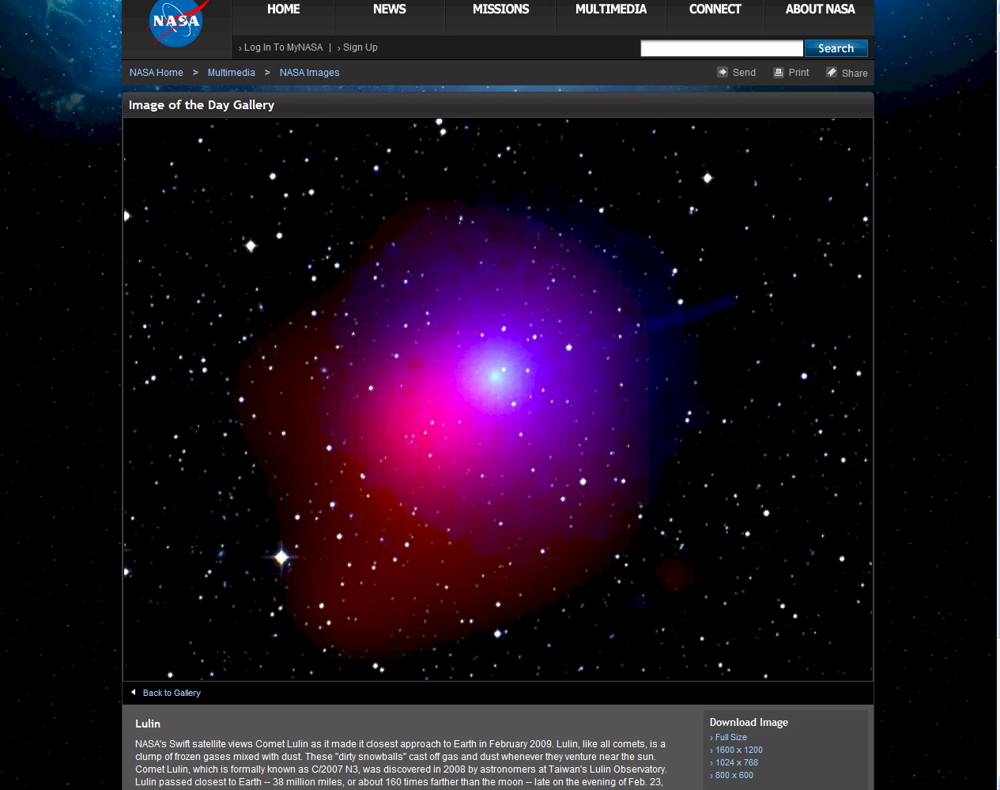

Slide 17
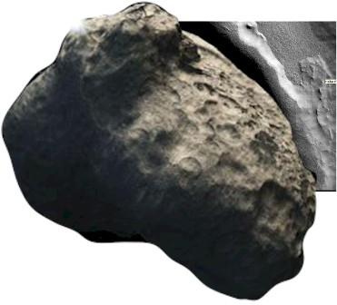
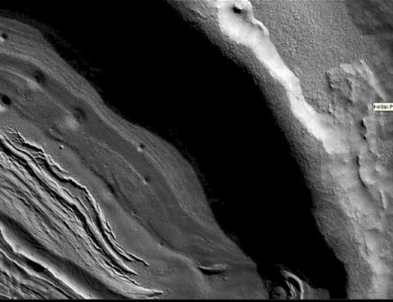

Slide 18
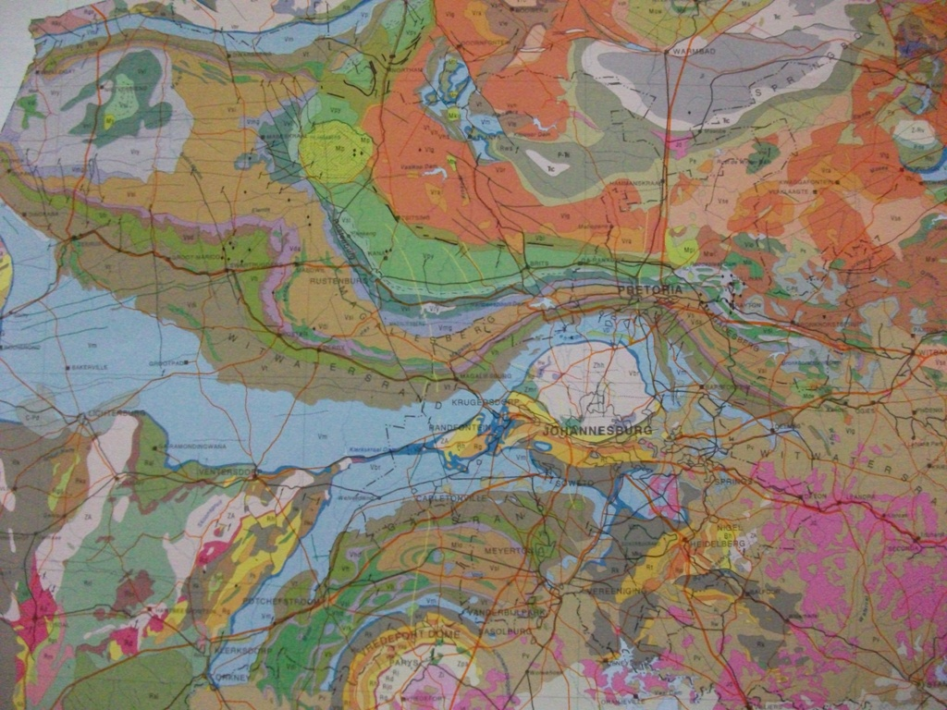
Massive surface disruption
Notes:
Same formation as Northcliff and the Magaliesberg – photos of both
Great extent, map of gold fields
Collage of headgears

Slide 19
Notes:
Then explode up to Fish River, Grand Canyon, Ayers Rock, USA, Spain, etc, etc montage around the world
Look for references to frequency of occurence of sedimentary rocks around the world

Slide 20
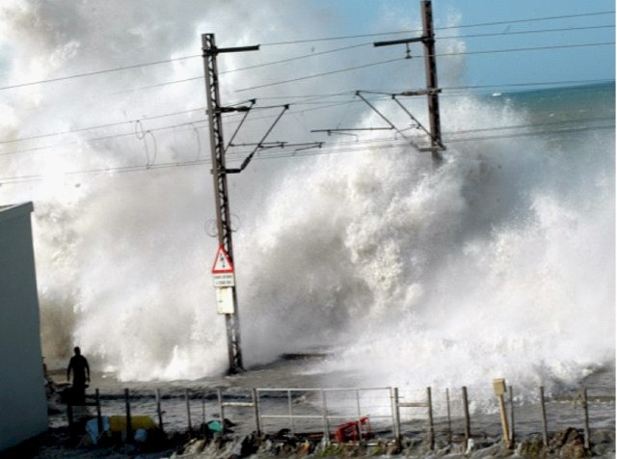
Notes:
Different degrees of metamorphosis – Swartruggens sandstone -- pressure and no heat, Northcliff quartzite – pressure AND heat
KOV, Nchanga, Phalaborwa, etc

Slide 21
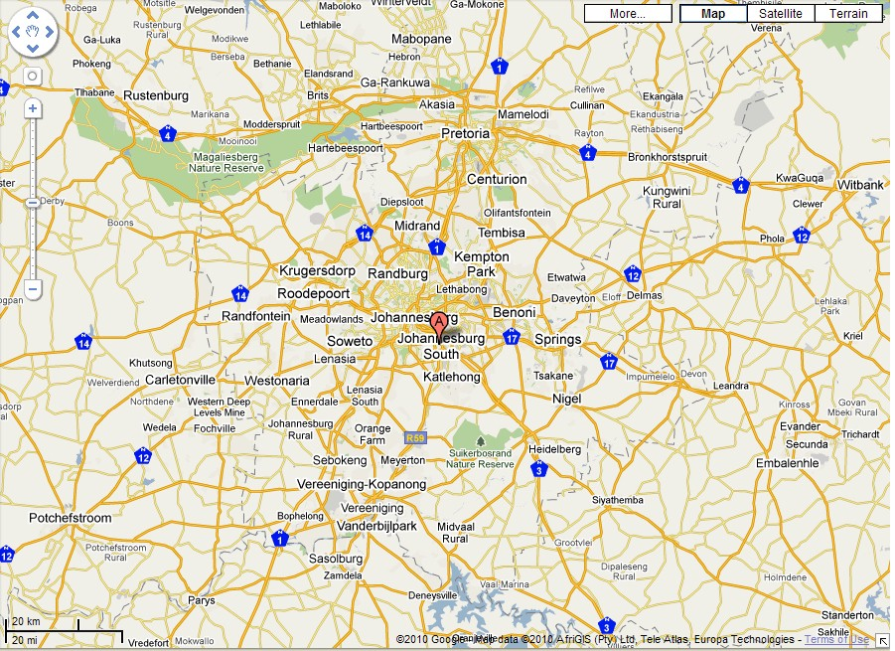
1852
1652
1807
1689
1736
1809
1902

Slide 22
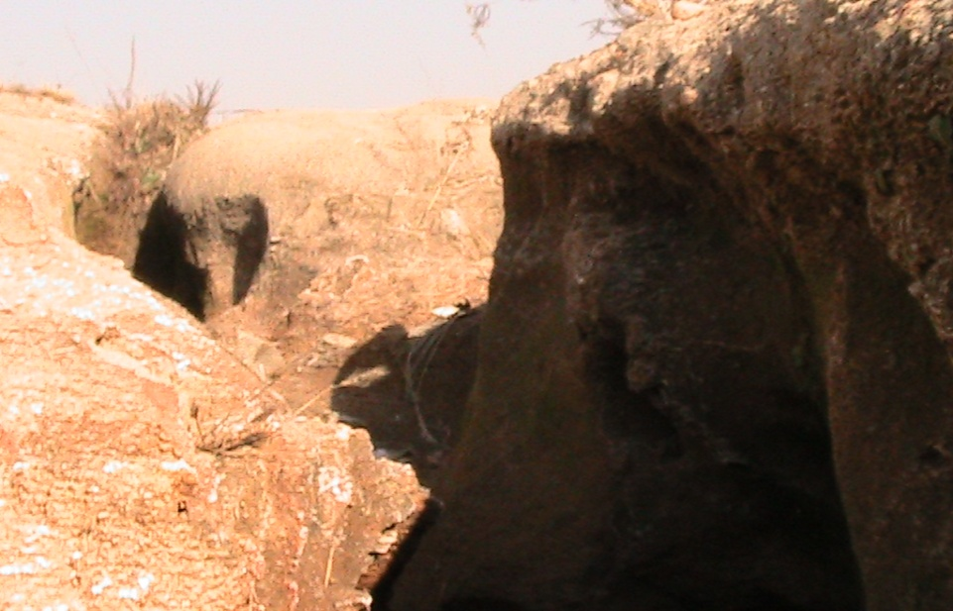
Notes:
Craighall, Fritz

Slide 23
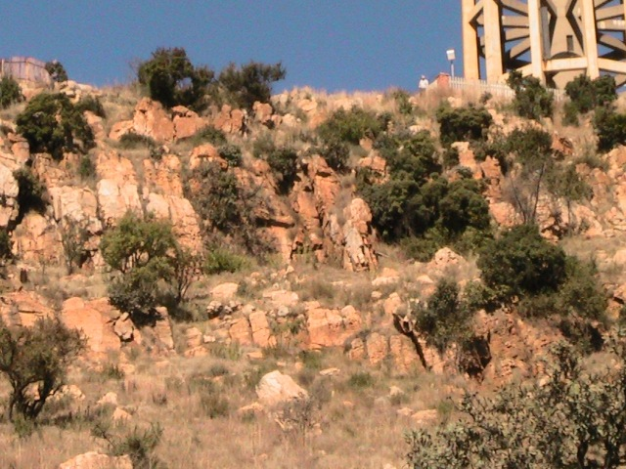
Notes:
Various cliff faces and hill tops – large boulders standing free, how did they get left behind, where has the material around them gone
Top of Table Mountain
Clean, sharp edges

Slide 24
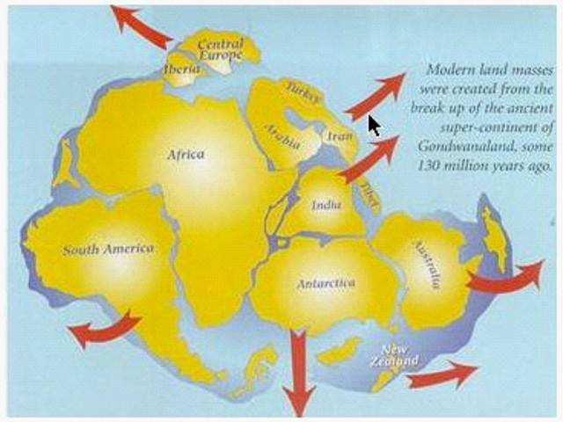
Notes:
If the rock was indeed washed into the Mozambique Channel we have another problem -- where did the Mozambique Channel come from?
And the Mariana Trench?
Huge holes into which huge volumes of material have seeming disappeared?
And where did the water come from and where did it go?

Slide 25
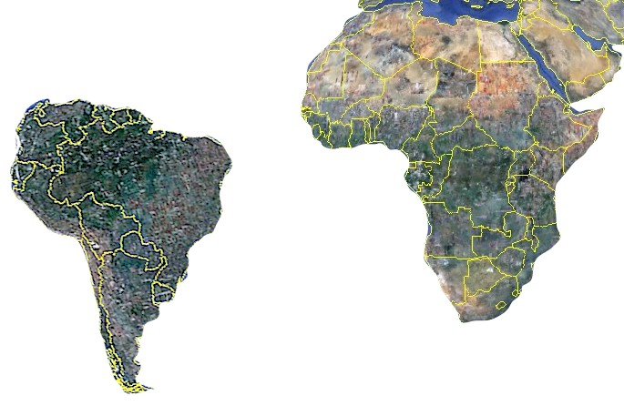
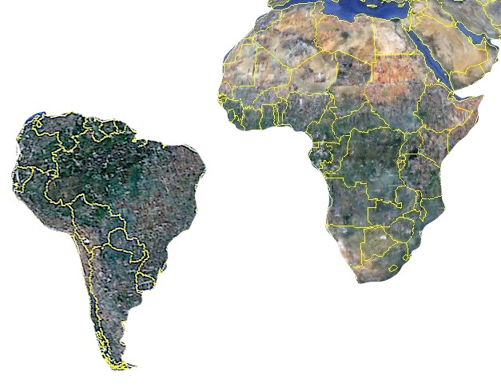
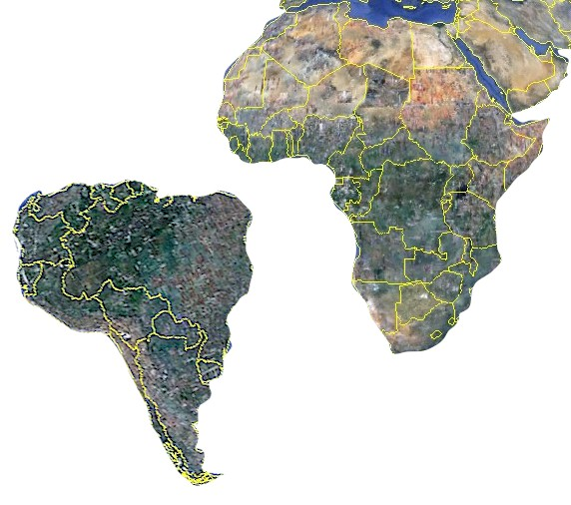
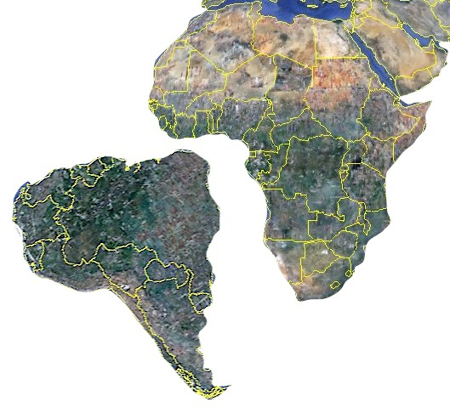
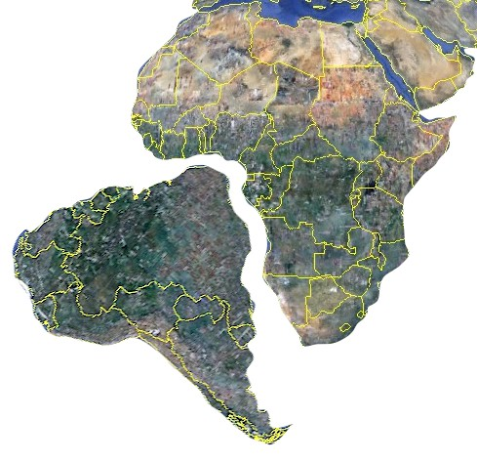
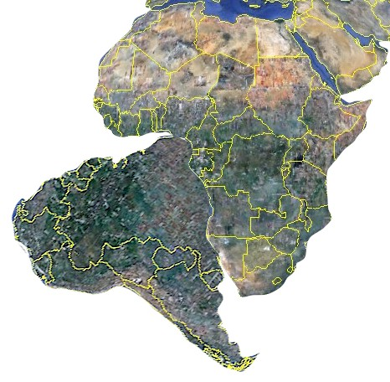
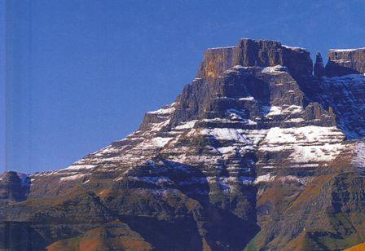
Notes:
If the rock was indeed washed into the Mozambique Channel we have another problem -- where did the Mozambique Channel come from?
And the Mariana Trench?
Huge holes into which huge volumes of material have seeming disappeared?
And where did the water come from and where did it go?

Slide 26
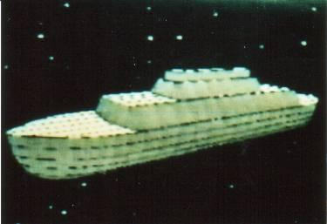
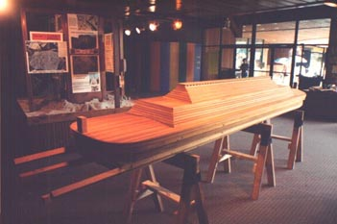
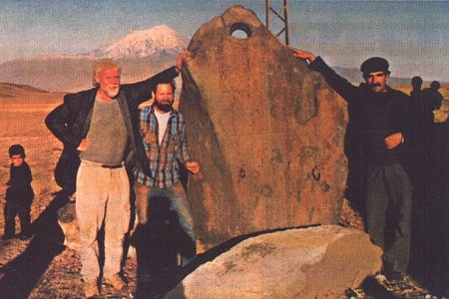
Notes:
Quote from Genesis about the flood – also later quotes?
Incidentally, the boat (Ark meaning container) has been found – artists impression of Ark from Jonathan or elsewhere

Slide 27
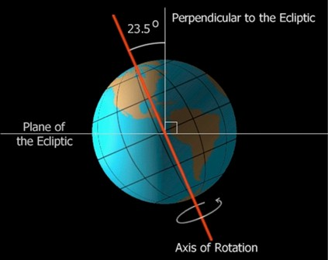
Notes:
If the rock was indeed washed into the Mozambique Channel we have another problem -- where did the Mozambique Channel come from?
And the Mariana Trench?
Huge holes into which huge volumes of material have seeming disappeared?
And where did the water come from and where did it go?

Slide 28
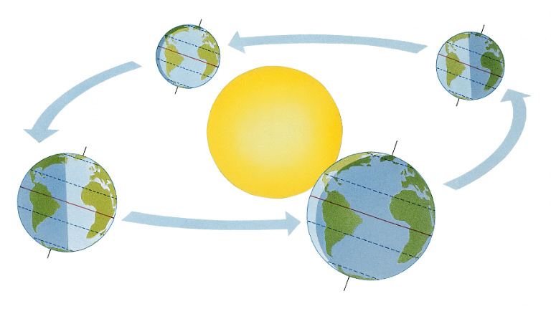
Notes:
If the rock was indeed washed into the Mozambique Channel we have another problem -- where did the Mozambique Channel come from?
And the Mariana Trench?
Huge holes into which huge volumes of material have seeming disappeared?
And where did the water come from and where did it go?

Slide 29
Data CD with supplementary material
The data CD that accompanies this set contains:
Electronic books cited in these presentations
Other ministry reference material – articles on diverse topics, many controversial and challenging
Copies of the PowerPoint presentations used for these videos to be used to extract material, translate, etc
Labels and other material required to duplicate and distribute these DVD’s
Copies of some material from my business relating to the effective business application of business computer systems and ERP systems in particular
Notes:
Advanced buildings and technology
Fire, pit, throne? Or blinding light – something that gives hope and something that portrays negative judgment
Possibly the graph from pit to mountain

Slide 30
Copyright releases, reprint rights, edit rights, distribution rights
You may copy and distribute all or part of the material on this disc set as you please – the ONLY consideration is YOUR conscience with regard to how you will be judged with regard to your actions on the Day of Judgment
Note that there is MERIT – credits -- if you do things that are valuable to the Kingdom of the Almighty such as distributing valuable material e.g. truth
There are demerits or penalties if you do things that are valuable to the kingdom of Satan such as distributing material valuable to Satan e.g. lies
You may copy part or all of the set
You may translate the presentations into other languages and extract material for your own presentations relating to this subject
You may add sub-titles to the videos or record voice-overs
If you do create new material please let us have a copy so we can make it available to others
Notes:
Advanced buildings and technology
Fire, pit, throne? Or blinding light – something that gives hope and something that portrays negative judgment
Possibly the graph from pit to mountain

Slide 31
Commercial considerations
I distribute these DVD sets for a donation to cover costs
You are welcome to make a donation to fund gifts to others
You are free to sell the DVD’s or give them away and to sell or give away any materials you derive from them
You are welcome to request the material as a gift and we will supply if and when funds permit
Notes:
Advanced buildings and technology
Fire, pit, throne? Or blinding light – something that gives hope and something that portrays negative judgment
Possibly the graph from pit to mountain

Slide 32
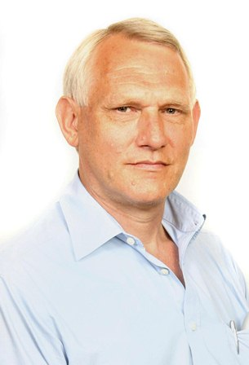
Donations
I believe that there IS value in these presentations and would like to distribute them as widely as possible
If you can afford it please consider making as large a donation as you are able towards the distribution of this material to those who cannot afford it
Thank you
Notes:
Advanced buildings and technology
Fire, pit, throne? Or blinding light – something that gives hope and something that portrays negative judgment
Possibly the graph from pit to mountain

Slide 33
Contacting me
I sincerely hope that you will find these videos informative and challenging
You can contact me at James@ETI-Ministries.org
Alternate email james@jar-a.com
Notes:
Advanced buildings and technology
Fire, pit, throne? Or blinding light – something that gives hope and something that portrays negative judgment
Possibly the graph from pit to mountain

